Slide 1


Texas Brownfields Programs
Alamo Area Council of
Governments Workshop
October 13, 2021

Slide 2
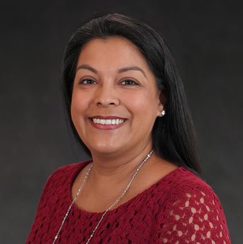

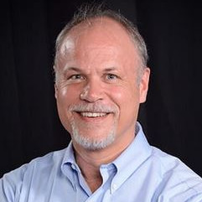

Kristian Livingston
Team Leader, Superfund Section
Peter Pope, P.G.
Manager, Site Remediation
Notes:
Leslie and I will be talking with you today about what our programs have to offer, the process of going through the Brownfields program and some examples of sites that have gone through each of our programs. We will have a time at the end for Q&A, but please feel free to drop question in the chat box throughout the presentation

Slide 3
What is TCEQ’s Jurisdiction?
Many Air, Water and Waste Programs, including Remediation.
Remediation Programs include, but are not limited to: Dry Cleaner Remediation, Leaking Petroleum Storage Tanks, Superfund, Industrial Hazardous Waste and Municipal Solid Waste
TCEQ jurisdiction does NOT include things like Asbestos Abatement; Mold Assessment and Remediation; and Oil and/or Gas Production

Slide 4
What is RRC’s Jurisdiction?
Oil and Gas Exploration and Production
Transportation of unrefined oil, gas, liquefied natural gas by pipeline
Natural gas processing including recycling, separation, compression
Solution mining for brine and storage of natural gas in salt domes
Bulk storage of crude oil
Commercial disposal facilities

Slide 5

TCEQ Eligibility
Must not be potentially liable under CERCLA (also known as Superfund)
Must not have used federal Leaking Understand Storage Tank funding at the site
No unresolved federal or state enforcement on the property
Must meet one of the following:
  Purchase of the property is planned by the applicant; or
  Delinquent property taxes make foreclosure by the taxing authority likely; or
  Redevelopment will result in ownership and/or long-term beneficial use by applicant.

Slide 6
RRC Eligibility Requirements
A redevelopment plan for the property
Oil & Gas operations on the property have been abandoned and there is no responsible party for cleanup
  Please note that RRC does not hold landowners responsible for cleanup
No unresolved federal or state enforcement on the property
Applicant and landowner agree to cooperate with RRC

Slide 7

TCEQ Brownfields Process:
Application
Planning & Application
Application is available on the following web link: https://www.tceq.texas.gov/remediation/bsa
Submit TCEQ Application to Brnflds@tceq.Texas.gov

Slide 8
TCEQ Brownfields Process:
Phase I ESA
Planning & Application
Phase I Environmental Site Assessment
If accepted into the program, a Phase I will be conducted by the TCEQ contractor to identify sources of possible contamination. Generally, this is completed within 3 months of application acceptance.

Slide 9
TCEQ Brownfields Process:
Phase II ESA
Planning & Application
Phase I Environmental Site Assessment
Phase II Environmental Site Assessment
Site activities are determined based on Phase I findings. May include soil and/or groundwater sampling

Slide 10
TCEQ Brownfields Process:
Cleanup Planning
Planning & Application
Phase I Environmental Site Assessment
Phase II Environmental Site Assessment
Cleanup Planning
The TCEQ program has limited funds for cleanup and a site may need to apply for a competitive EPA cleanup grant and/or obtain other funding sources. TCEQ may provide support for cleanup and redevelopment planning.

Slide 11
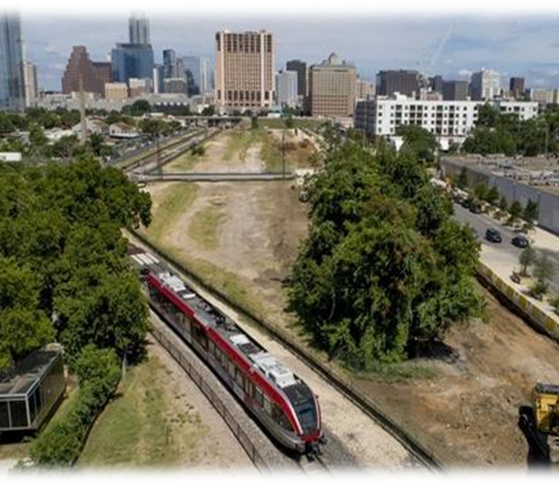
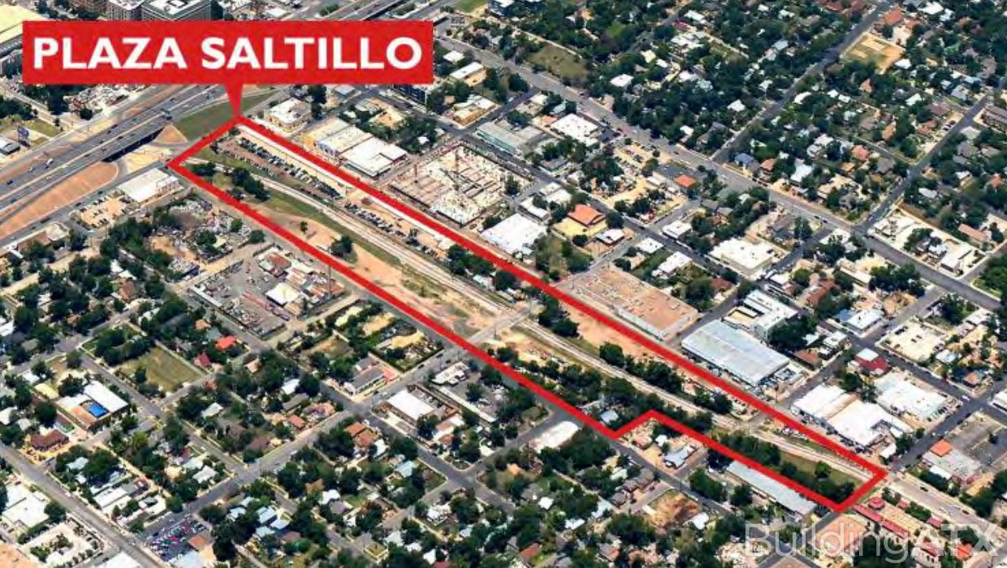
Plaza Saltillo Railyard : BEFORE
Approximately 12 acres in East Austin, Texas
The Plaza Saltillo Railyard was located in east Austin for over a century. In 1995 Capital Metro purchased the railyard as part of incorporating Plaza Saltillo site into a metro rail system

Slide 12
Plaza Saltillo Railyard in Brownfields
Planning & Application
Applicants:
City of Austin Brownfields & Capital Metro
Phase I Environmental Site Assessment
Identified RECS:
Former railyard operations, underground storage tanks, oil storage
Phase II Environmental Site Assessment
TCEQ Investigation:
Soil and groundwater sampling
EPA Additional Investigation:
Targeted Brownfield assessment by EPA
Cleanup Planning
Chose to enter the TCEQ Voluntary Cleanup Program: Removal Action, Physical and Institutional Controls placed on Property , Received certificates of completion to redevelop

Slide 13
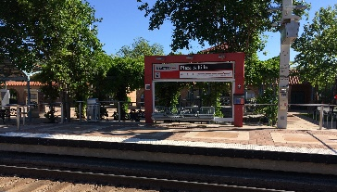
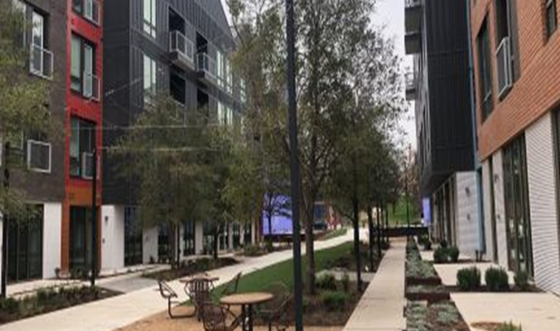
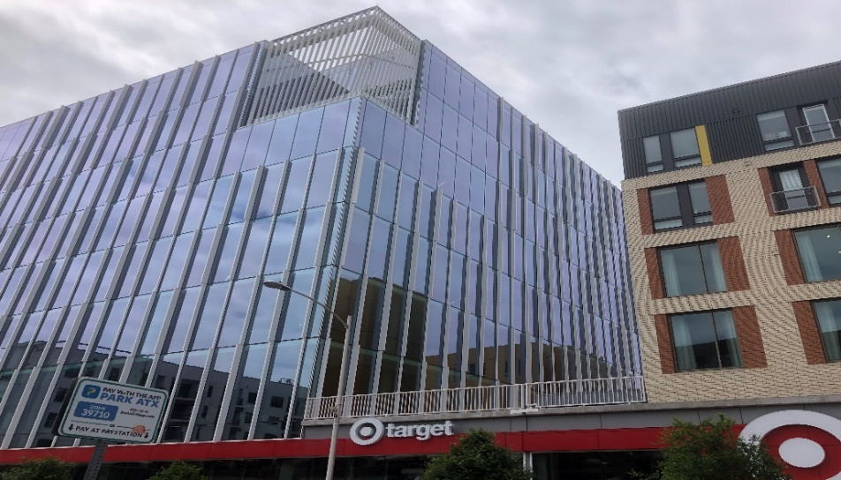
Plaza Saltillo Railyard in Brownfields
Redeveloped as office space, residential, and retail space anchored by Whole Foods and Target.
Plaza Saltillo is now a metro rail station and community courtyard space available on the East side of Austin.

Slide 14
Plaza Saltillo Railyard in Brownfields
Redeveloped as office space, residential, and retail space anchored by Whole Foods and Target.
Plaza Saltillo is now a metro rail station and community courtyard space available on the East side of Austin.

Slide 15
RRC Brownfields Process:
Application
Application
Application is available on the following web link: https://www.rrc.texas.gov/oil-and-gas/environmental-cleanup-programs/site-remediation/grant-cleanup-programs/brp/
Submit TCEQ Application to SR-VCP-BRP@rrc.texas.gov

Slide 16
RRC Brownfields Process:
Phase I ESA
Application
Phase I
If accepted, the RRC will conduct a Phase I and identify sources of possible contamination.
The timeframe of completing the Phase I will depend on current funding. Generally, it will be completed within six months of application acceptance.

Slide 17
RRC Brownfields Process:
Phase II ESA
Application
Phase I
Phase II
If the Phase I identifies sources of contamination, the RRC will then perform a Phase II Assessment.
Generally, this involves the installation of soil borings and groundwater monitoring wells, as needed.

Slide 18
RRC Brownfields Process:
Cleanup
Application
Phase I
Phase II
Cleanup
Should a Phase II indicate that remediation is needed, the RRC can preform a cleanup of a site, as needed.
The RRC Site Remediation Section has funds from oil and gas regulatory fees and operator penalties to cleanup abandoned oil and gas sites at not cost to innocent landowners.

Slide 19
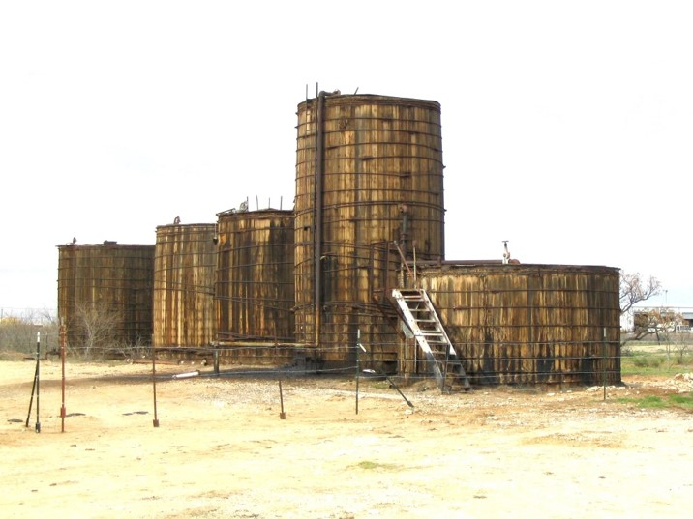
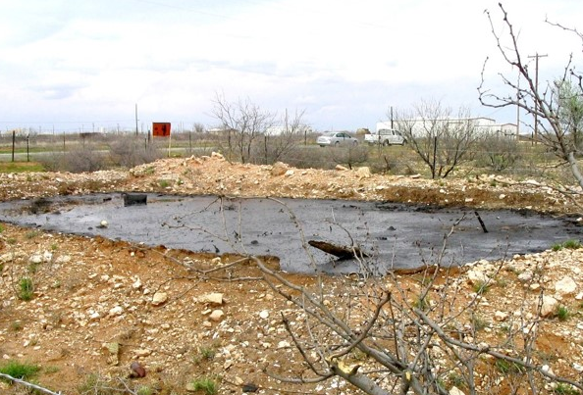
Andrews Bird Park: BEFORE
A 4.5-acre saltwater disposal facility in Andrews, Texas
Site is located next to the city’s water treatment plant making it the perfect location for a bird park
The site had been on the RRC’s state-managed cleanup list since 1999. In 2004, RRC’s Brownfield staff notified the City of Andrews that the site would be eligible for a targeted brownfields assessment.

Slide 20
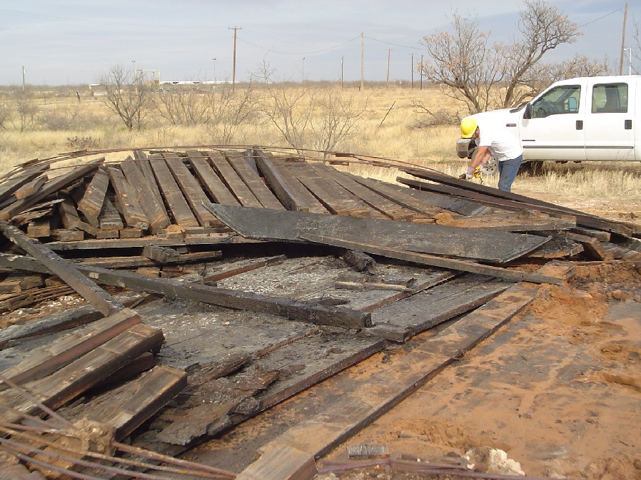
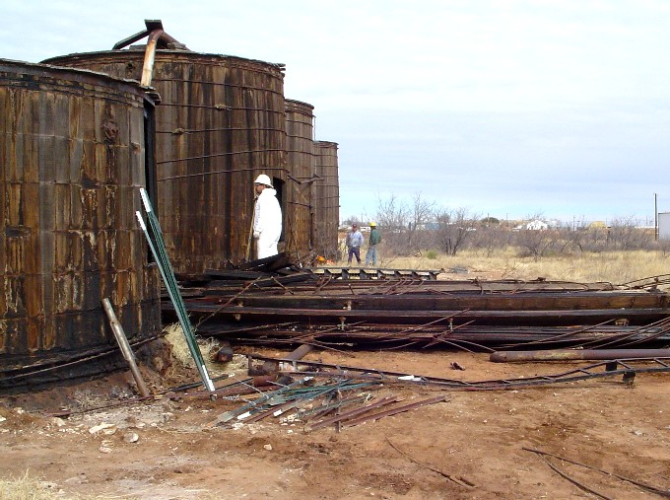
Andrews Bird Park in Brownfields
Planning & Application
Applicants:
City of Andrews
Phase I Environmental Site Assessment
Identified RECS:
Five wooden tanks and one disposal pit, all containing oil/gas wastes
Gauged tanks, sampled contents of pit and tanks for water characterization, collected soil and groundwater samples, conducted NORM survey
Phase II Environmental Site Assessment
Cleanup
Emptied wastes in tanks, dismantled tanks, excavated soils in pit area and beneath tanks, disposed of NORM wastes

Slide 21
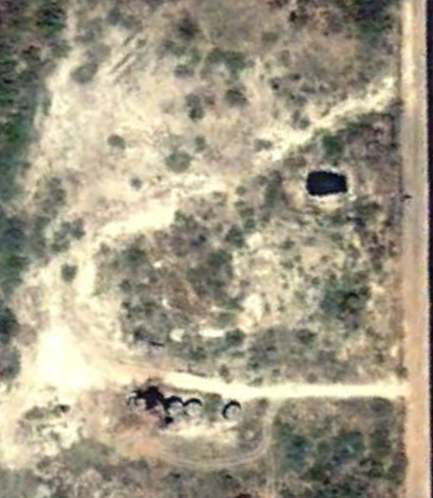
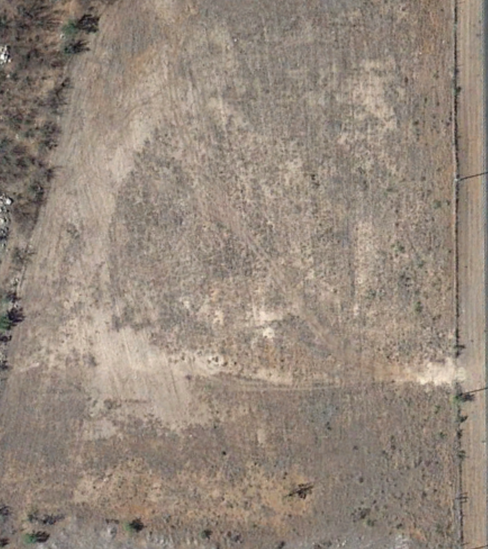
Before:
After:

Slide 22
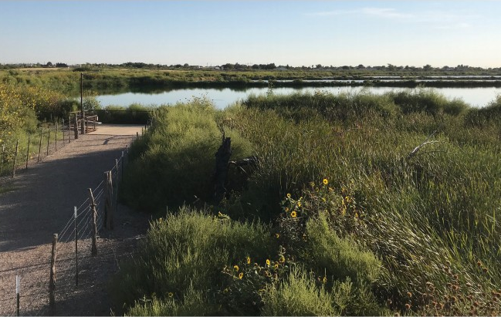
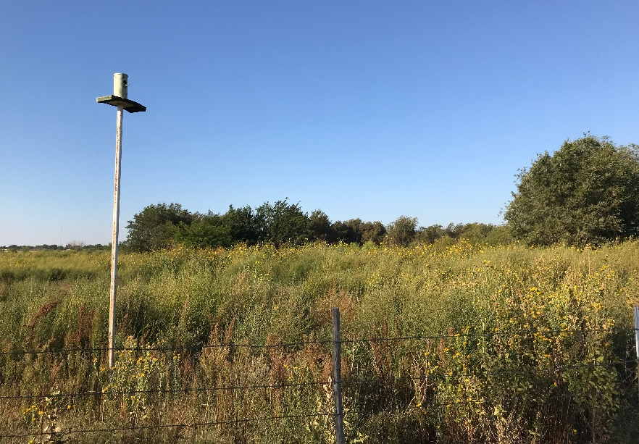
Andrews Bird Park: After
Part of a larger project to improve Andrews and encourage eco-tourism
Hiking trails and bird viewing decks were built using grant funds from Texas Parks and Wildlife
50+ bird species have been spotted at this site

Slide 23

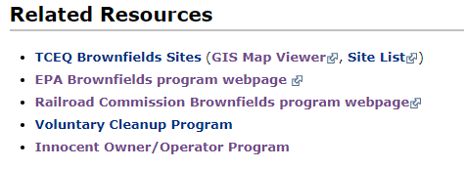
TCEQ Public Resources
Brownfields Specific Resources
Brownfields Site GIS Map Viewer
TCEQ Brownfields Site List
Agency Resources
Central Registry
Central File Room Online

Slide 24
RRC Public Resources
GIS Map Viewer
  View wells, pipelines, OCP, VCP and Brownfield locations
Research Database
  View well records, operator information, VCP/Brownfield reports, inspection reports
Brownfields Bulletin Signup
  Stay in contact with the RRC’s Brownfields program by singing up for our quarterly bulletin
Brownfield Success Stories
  Read about the RRC’s successfully remediated and redeveloped Brownfield sites across Texas

Slide 25

Peter Pope
Manager, Site Remediation
Peter.Pope@rrc.texas.gov
512-463-8202
Kristian Livingston
Team Leader, Superfund Section
Kristian.livingston@tceq.texas.gov
512-239-2252

