Slide 1
Legislative update
Presented by:
Clarissa M. Rodriguez, Partner T. Daniel Santee, Partner Denton Navarro Rocha Bernal & Zech, P.C.

Slide 2
87th Legislature by the Numbers
6,927 bills filed 2,156 bills tracked (31%)
1,073 bills passed 247 bills tracked passed
1,429 bills passed (86th Legislative Session)

Slide 3
Cutting Room Floor
Community censorship
Sales tax sourcing
Partisan city elections
Preemption of city regulation of state licensees
Expansion of videoconferencing and teleconferencing under TOMA
Land development shot clock expansion
ETJ removal
Mandatory sick leave
Chickens, rabbits, and bees
Omnibus disaster authority during pandemic
Extension of Chapter 313 incentives
Preemption of city employment regulations
Expanded liability for ballot language

Slide 4
Public Safety

Slide 5
H.B. 929 (Sherman/West) Occupations Code § 1701.655 – Body Worn Cameras: provides that: (1) a body worn camera policy must: (a) include provisions related to the collection of a body worn camera, including the applicable video and audio recorded by the camera, as evidence; (b) require a peace officer who is equipped with a body worn camera and actively participating in an investigation to keep the camera activated for the entirety of the officer’s active participation in the investigation unless the camera has been deactivated in compliance with such policy; and (2) a peace officer equipped with a body worn camera may choose not to activate a camera or may choose to discontinue a recording currently in progress for any encounter with a person that is not related to an investigation. (Effective September 1, 2021.)

Slide 6
H.B. 1758 (Krause/Birdwell) Code of Criminal Procedure – Unmanned Aircraft: this bill: (1) requires each law enforcement agency that uses or intends to use a drone for law enforcement purposes to: (a) adopt a written policy regarding the agency’s use of force by means of a drone, before the agency first uses a drone, and update the policy as necessary; and (b) not later than January 1 of each even-numbered year submit the policy to the Texas Commission on Law Enforcement (TCOLE) in the manner prescribed by TCOLE; and (2) provides that, notwithstanding any other law, the use of force, including deadly force, involving a drone is justified only if: (a) at the time the use of force occurred, the actor was employed by a law enforcement agency; and (b) the use of force: (i) would have been justified under certain other law; and (ii) did not involve the use of deadly force by means of an autonomous drone; and (c) before the use of force occurred, the law enforcement agency employing the actor adopted and submitted to TCOLE a policy on the agency’s use of force by means of a drone, as described in (1), above, and the use of force conformed to the requirements of that policy. (Effective September 1, 2021.)

Slide 7
S.B. 69 (Miles/White) Chapter 2, Code of Criminal Procedure – Use of Force: provides that: (1) a peace officer has a duty to intervene to stop or prevent another peace officer from using force against a person suspected of committing an offense if: (a) the amount of force exceeds that which is reasonable under the circumstances; and (b) the officer knows or should know that the other officer’s use of force: (i) violates state or federal law; (ii) puts a person at risk of bodily injury, and is not immediately necessary to avoid imminent bodily injury to a peace officer or other person; and (iii) is not required to apprehend the person suspected of committing an offense; (2) a peace officer who witnesses the use of excessive force by another peace officer shall promptly make a detailed report of the incident and deliver the report to the supervisor of the peace officer making the report; and (3) the use of any force, by any person, including a peace officer or person acting in and at the direction of an officer, in connection with the arrest of another person, is not a justified use of force if such force is used in a manner that impedes the normal breathing or circulation of the blood of the person by applying pressure to the person’s throat, neck, or torso or by blocking the person’s nose or mouth. (Effective September 1, 2021.)

Slide 8
H.B. 624 (Shine/Campbell) Penal Code – Offense Against Public Servant: increases the criminal penalty for certain offenses committed in retaliation for, or on account of, a person’s service or status as a public servant. (Effective September 1, 2021.)

Slide 9
Contracts

Slide 10
S.B. 2116 (Campbell/Parker) Business & Commerce Code Adding Chapter 113 – Critical Infrastructure: among other things, prohibits a city from entering into a contract or other agreement relating to “critical infrastructure” (defined to mean a communication infrastructure system, cybersecurity system, electric grid, hazardous waste treatment system, or water treatment facility) in this state with a company if the city knows that the company is: (1) owned by or the majority of stock or other ownership interest of the company is held or controlled by: (a) individuals who are citizens of China, Iran, North Korea, Russia, or other designated countries; or (b) a company or other entity, including a governmental entity, that is owned or controlled by citizens of or is directly controlled by the government of China, Iran, North Korea, Russia, or other designated countries; or (2) headquartered in China, Iran, North Korea, Russia, or other designated countries. (Effective September 1, 2021.)

Slide 11
S.B. 13 (Birdwell/P. King) Government Code Adding Chapter 809 – Energy Boycott: among other things, prohibits a city from entering into a contract with a value of $100,000 or more that is to be paid from public funds with a company with more than 10 full-time employees for goods or services unless the contract contains a written verification from the company that it: (1) does not boycott energy companies; and (2) will not boycott energy companies during the term of the contract. (Effective September 1, 2021.)

Slide 12
S.B. 19 (Schwertner/Capriglione) Government Code Adding Chapter 2274 – Firearms: among other things, (1) prohibits a governmental entity from entering into a contract with a value of $100,000 or more that is to be paid from public funds with a company with more than 10 full-time employees for the purchase of goods or services unless the contract contains a written verification from the company that it: (a) does not have a practice, policy, guidance, or directive that discriminates against a firearm entity or firearm trade association; and (b) will not discriminate during the term of the contract against a firearm entity or firearm trade association; and (2) provides that the prohibition in (1) does not apply to a city that (a) contracts with a sole-source provider, or (b) the city does not receive any bids from a company that is able to provide the required verification required by (1). (Effective September 1, 2021.)

Slide 13
S.B. 219 (Hughes/Leach) Business & Commerce Code Adding Chapter 59 – Real Property Construction and Repair: this bill: (1) provides that, in regard to a contract for the construction or repair of improvement to real property, a contractor is not responsible for the consequences of design defects in and may not warranty the accuracy, adequacy, sufficiency, or suitability of plans, specifications, or other design documents provided to the contractor by a person other than the contractor’s agents, contractors, fabricators, or suppliers, or its consultants, of any tier; (2) requires a contractor, within a reasonable time of learning of a defect, inaccuracy, inadequacy, or insufficiency in the plans, specifications, or other design documents, disclose in writing to the person with whom the contractor enters into a contract the existence of any known defect in the plans, specifications, or other design documents that is 66 discovered by the contractor, or that reasonably should have been discovered by the contractor using ordinary diligence, before or during construction; (3) excepts certain contracts from the new provisions regarding responsibility for defects in plans and specifications described in (1) and (2); (4) requires a construction contract for architectural or engineering services or a contract related to the construction or repair of an improvement to real property that contains architectural or engineering services as a component to require that the architectural or engineering services be performed with the professional skill and care ordinarily provided by competent architects or engineers practicing under the same or similar circumstances and professional license, and a provision in a contract with a different standard of care is void and unenforceable; and (5) provides that certain limitations on a contractor’s responsibility for certain defects do not apply to a design build contract. (Effective September 1, 2021, except for (5) which clarifies existing law and applies to a contracted entered into before, on, or after September 1, 2021.)

Slide 14
S.B. 780 (Hinojosa/Raymond) Government Code Adding Chapter 793 – Intergovernmental Agreements: allows a local government to enter into an intergovernmental support agreement with a branch of the armed forces of the United States under the National Defense Authorization Act to provide installation-support services to a military installation located in Texas. (Effective immediately.)

Slide 15
H.B. 2116 (Krause/Powell) Civil Practice & Remedies Code– Architects and Engineers: this bill provides that: (1) with certain exceptions, a covenant or promise in, in connection with, or collateral to a contract for engineering or architectural services related to an improvement to real property is void and unenforceable if the covenant or promise provides that a licensed engineer or registered architect must defend a party, including a third party against a claim based wholly or partly on the negligence of, fault of, or breach of contract by the owner, the owner’s agent, the owner’s employee, or another entity over which the owner exercises control; (2) a covenant or promise in, in connection with, or collateral to a contract for engineering or architectural services related to an improvement to real property may provide for the reimbursement of an owner’s reasonable attorney’s fees in proportion to the engineer’s or architect’s liability; (3) notwithstanding (1), an owner that is a party to a contract for engineering or architectural services related to an improvement to real property may require in the contract that the engineer or architect name the owner as an additional insured under any of the engineer’s or architect’s insurance coverage to the extent additional insureds are allowed under the policy and provide any defense to the owner provided by the policy to a named insured; and (4) a construction contract for engineering or architectural services related to the construction or repair of an improvement to real property must require that the architectural or engineering services be performed with the professional skill and care ordinarily provided by competent architects or engineers under the same or similar circumstances and professional license, and a provision in a contract establishing a different standard is void and unenforceable. (Effective September 1, 2021.)

Slide 16
Community and Economic Development

Slide 17
H.B. 2025 (Hunter/Huffman) Government Code § 2058.001– Federal Census: this bill, among other things, provides that, until September 1, 2023, a statute that applies to a political subdivision having a certain population according to the most recent federal census: (1) continues to apply to the same political subdivisions to which the statute applied under the 2010 federal census, regardless of whether the political subdivisions continue to have the populations prescribed by the statute according to the 2020 federal census; and (2) does not apply to a political subdivision to which the statute did not apply under the 2010 federal census, regardless of whether the political subdivision has the population prescribed by the statute according to the 2020 federal census. (Effective immediately.)

Slide 18
H.B. 1475 (Cyrier/Buckingham) ) Local Government Code § 211.009 – Board of Adjustment: provides that, in exercising its authority to grant or deny a variance, a board of adjustment may consider the following as grounds to determine whether compliance with the zoning ordinance as applied to a structure would result in an unnecessary hardship: (1) whether the financial cost of compliance is greater than 50 percent of the appraised value of the structure as shown on the most recent certified appraisal roll; (2) whether compliance would result in a loss to the lot on which the structure is located of at least 25 percent of the area on which development may physically occur; (3) whether compliance would result in the structure not being in compliance with a requirement of a city ordinance, building code, or other requirement; (4) whether compliance would result in the unreasonable encroachment on an adjacent property or easement; or (5) whether the city considers the structure to be a nonconforming structure. (Effective September 1, 2021.)

Slide 19
H.B. 738 (Paul/Nichols) Local Government Code § 214.212 – Building Codes: this bill: (1) provides that the 2012 version of the International Residential Code is the residential building code in this state, and the 2012 version of the International Building Code is the commercial building code in this state; (2) authorizes a city to establish procedures to adopt local amendments “that may add, modify, or remove requirements” set by the codes in (1), above, but only if the city: (a) holds a public hearing on the local amendment before adopting the amendment; and (b) adopts the local amendment by ordinance; (3) prohibits a city from enacting an ordinance, bylaw, order, building code, or rule requiring the installation of a multipurpose residential fire protection sprinkler system or any other fire sprinkler protection system in a new or existing one- or two-family dwelling; and (4) excepts from the prohibition in (3), above, a city that has enacted an ordinance, bylaw, order, building code, or rule requiring the installation of a multipurpose residential fire protection sprinkler system or any other fire protection sprinkler system in a new or existing one- or two-family dwelling on or before January 1, 2009. (Effective January 1, 2022, except that a requirement that a city establish rules and take other necessary action to implement (1) and (2) before January 1, 2022, is effective September 1, 2021.)

Slide 20
H.B. 1554 (Rogers/ Buckingham) Local Government Code § 377.072 – Municipal Development Districts: authorizes a municipal development district to use money in the development project fund to pay the costs of planning, acquiring, establishing, developing, constructing, or renovating one or more development projects located outside the district if: (1) the project is located in the extraterritorial jurisdiction of the city that created the district; (2) the board determines that the development project will provide an economic benefit to the district; and (3) the following entities, as applicable, approve the development project by resolution: (a) the city that created the district; and (b) each city in whose corporate limits or extraterritorial jurisdiction the project is located. (Effective Immediately.)

Slide 21
H.B. 1929 (Wilson/Buckingham) Local Government Code § 212.172 – ETJ Development Agreements: this bill: (1) defines the term “contract” to mean a contract for an ETJ development agreement and defines such a contract to be a program authorized by the legislature under Article III, Section 52-a of the Texas Constitution; (2) provides that: (a) a city that enters into a contract described in (1), above, waives immunity from suit for the purpose of adjudicating a claim for breach of contract; (b) actual damages (but not exemplary damages), specific performance, or injunctive relief may be granted in an adjudication brought against a city for breach of a contract, and that damages are limited to (i) the balance due and owed by the city under the contract, (ii) any amount owed by the landowner as a result of the city’s failure to perform under the contract, including compensation for the increased cost of infrastructure as a result of delays or accelerations caused by the city, (iii) reasonable attorney’s fees, and (iv) interest; (3) provides that a contract described in (1), above, that is entered into by a city and a landowner prior to the effective date of this bill is validated, enforceable, and may be adjudicated subject to the terms and conditions of this bill; and (4) annexation by a city of the land subject to a contract does not invalidate the enforceability of the contract. (Effective September 1, 2021.)

Slide 22
S.B. 374 (Seliger/Shine) Local Government Code § 43.1055– Annexation of Rights-of-Way: this bill provides that: (1) a city annexing an area on request of the owners, an area with less than 200 population by petition, an area with at least 200 population by election, or certain special districts may also annex with the area the right-of-way of a street, highway, alley or other public way or of a railway line spur, or roadbed that is: (a) contiguous and runs parallel to the city’s boundaries; and (b) contiguous to the area being annexed; (2) a city may annex a right-of-way described under (1), above, only if: (a) the city provides written notice of the annexation to the owner of the right-of-way not later than the 61st day before the date of the proposed annexation; and (b) the owner of the right-of-way does not submit a written objection to the city before the date of the proposed annexation; and (3) certain width requirements do not apply to the annexation of a right-of-way under (1), above. (Effective immediately.)

Slide 23
S.B. 1338 (Zaffirini/Sanford) Local Government Code § 43.004 – Annexation/Development Agreements: this bill: (1) requires that, at the time a city makes an offer to a landowner to enter into an agreement in which the landowner consents to annexation or makes an offer to enter into a development agreement, the city provide the landowner with a written disclosure: (a) that the landowner is not required to enter into the agreement; (b) of the authority under which the city may annex the land with references to relevant law; (c) with a plain-language description of the annexation procedures applicable to the land; (d) whether the procedures require the landowner’s consent; and (e) with a statement regarding the city’s waiver of immunity to suit; and (2) provides that a failure to provide the disclosure in (1), above, makes the agreement void. (Effective September 1, 2021.)

Slide 24
S.B. 1168 (Campbell/C. Bell) Local Government Code § 42.9025 – Extraterritorial Jurisdiction: in an area in a city’s extraterritorial jurisdiction that has been disannexed under certain law or for which the city has attempted and failed to obtain consent for annexation under certain law, this bill: (1) prohibits a city from imposing a fine or fee on a person on the basis of an activity that occurs wholly in the area, or the management or ownership of property located wholly in the area; and (2) provides that the prohibition in (1), above, does not apply to a fine or fee for water, sewer, drainage, or other related utility services. (Effective immediately.)

Slide 25
H.B. 2404 (Meyer/Zaffirini) Government Code § 403.0246 & 403.0247 – Chapter 380 Economic Development Agreements: this bill, among other things: 1. requires the comptroller to create and make accessible on the Internet a database, to be known as the Chapter 380 and 381 Agreement Database, that contains information regarding all city and county economic development agreements under Chapters 380 and 381 of the Local Government Code, respectively; 2. provides that, for each local economic development agreement described in Number 1, above, the database must include: (a) the name of the local government that entered into the agreement; (b) a numerical code assigned to the local government by the comptroller; (c) the address of the local government’s administrative offices and public contact information; (d) the name of the appropriate officer or other person representing the local government and that person’s contact information; (e) the name of any entity that entered into the agreement with the local government; (f) the date on which the agreement went into effect and the date on which the agreement expires; (g) the focus or scope of the agreement; (h) an electronic copy of the agreement; and (i) the name and contact information of the individual reporting the information to the comptroller; 3. requires a city, not later than the fourteenth day after entering into, amending, or renewing an economic development agreement under Chapter 380 of the Local Government Code, to submit to the comptroller the information described by Number 2, above, in the form and manner prescribed by the comptroller in addition to providing a direct link on the city’s website to the location of the agreement information published on the comptroller’s website;

Slide 26
H.B. 2404 (Meyer/Zaffirini) Government Code § 403.0246 & 403.0247 – Chapter 380 Economic Development Agreements Continued…
4. authorizes the comptroller to consult with the appropriate officer of, or other person representing, each local government that enters into a local economic development agreement to obtain the information necessary to operate and update the database; 5. requires the comptroller to enter the relevant information into the database not later than the 15th business day after the date the comptroller receives the information from the providing local government; 6. requires the information, including a copy of the agreement, to remain accessible to the public through the database during the period the agreement is in effect; 7. provides that if a local government that enters into a local economic development agreement described in Number 1, above, does not comply with the requirement to provide information to the comptroller, the comptroller shall send a written notice to the local government describing the information that must be submitted to the comptroller and inform the local government that if the information is not provided on or before the 30th day after the date the notice is provided, the local government will be subject to a civil penalty of $1,000; 8. provides that, if a local government does not report the required information to the comptroller, the local government is liable to the state for a civil penalty of $1,000 and the attorney general may sue to collect a civil penalty; and 30 9. creates a defense to an action brought under Number 8, above, that the local government provided the required information or documents to the extent the information or documents are not exempt from disclosure or confidential under the Public Information Act.

Slide 27
Questions?
T. Daniel Santee tdsantee@rampagelaw.com
Denton Navarro Rocha Bernal & Zech, P.C. 2517 N. Main San Antonio, TX 78212 (210) 227-3243

Slide 28
BREAK

Slide 29
Elections

Slide 30
H.B. 1622 (Guillen/ Hughes) Election Code § 87.121– Early Voting Reporting: this bill: (1) allows a person registered to vote in the county where the early voting clerk is conducting early voting to submit a complaint to the secretary of state stating that an early voting clerk has not delivered to the local canvassing authority a report of the early voting votes cast not later than the time of the local canvass; (2) requires the secretary of state to create and maintain a system for receiving and recording complaints; and (3) requires the secretary of state to maintain a record indicating which counties and early voting clerks have failed to comply with the requirements of early voting reporting. (Effective September 1, 2021.)

Slide 31
H.B. 4555 (Guillen/Hinojosa) Election Code § 141.031 – Eligibility for Public Office: this bill: (1) requires a candidate’s application for a place on the ballot to include an indication that the candidate has either not been finally convicted of a felony or, if so convicted, has been pardoned or otherwise released from the resulting disabilities; (2) requires a candidate who has been convicted of a felony to include in the candidate’s application for a place on the ballot proof that the candidate is eligible for public office; and (3) creates a Class B misdemeanor offense for a person to knowingly provide false information in an application for a place on the ballot regarding whether the person has been finally convicted of a felony or has been pardoned or otherwise released from the resulting disabilities. (Effective September 1, 2021.)

Slide 32
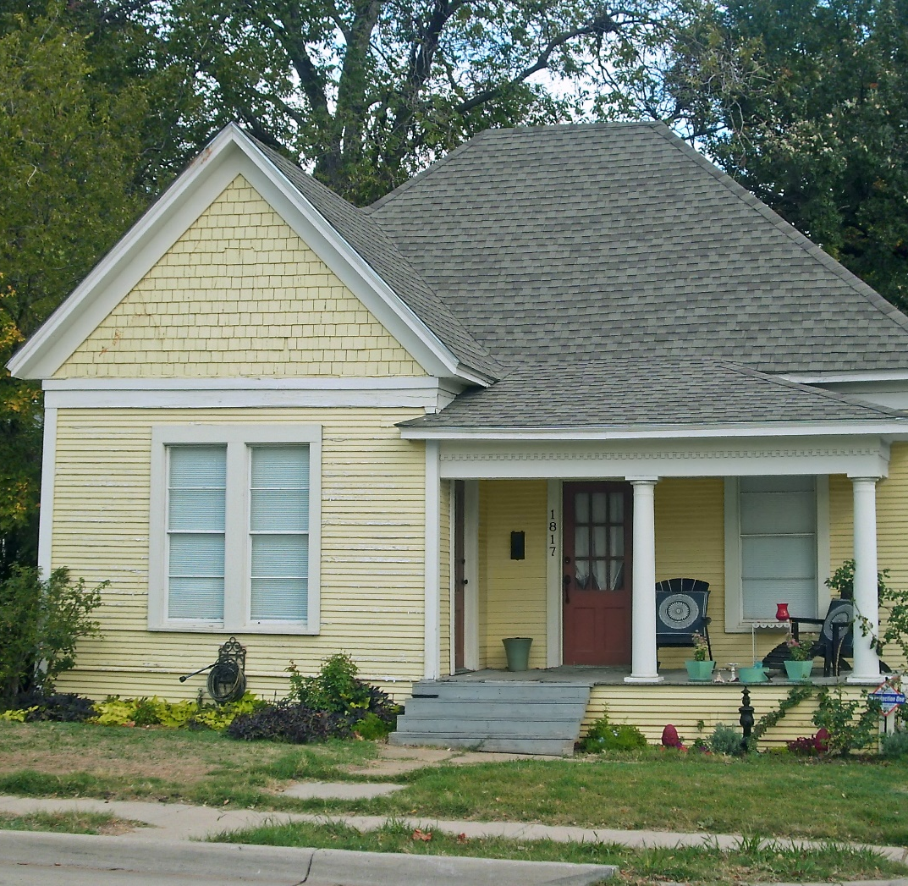
S.B. 1111 (Bettencourt/Paul) Election Code § 1.015 – Residency: this bill, among other things, modifies the definition of “residence” for purposes of elections to provide that: (1) a person may not establish residence for the purpose of influencing the outcome of a certain election; (2) a person may not establish a residence at any place the person has not inhabited; and (3) a person may not designate a previous residence as a home and fixed place of habitation unless the person inhabits the place at the time of designation and intends to remain. (Effective September 1, 2021.)

Slide 33
S.B. 1116 (Bettencourt/Bucy) Election Code § 65.016 – Posting Election Information: requires, among other things, that: (1) a city that holds an election and maintains an Internet website shall post on its public website the following as soon as practicable after the election: (a) the results of each election; (b) the total number of votes cast; (c) the total number of votes cast for each candidate or for or against each measure; (d) the total number of votes cast by personal appearance on election day; (e) the total number of votes cast by personal appearance or mail during the early voting period; and (f) the total number of counted and uncounted provisional ballots cast; (2) information required to be posted under (1), above, must be accessible without having to make more than two selections or view more than two network locations after accessing the city’s Internet website home page; and (3) not later than the 21st day before election day, a city that holds an election and maintains an Internet website shall post on the public Internet website: (a) the date of the next election; (b) the location of each polling place; (c) each candidate for an elected office on the ballot; and (d) each measure on the ballot. (Effective September 1, 2021.)

Slide 34
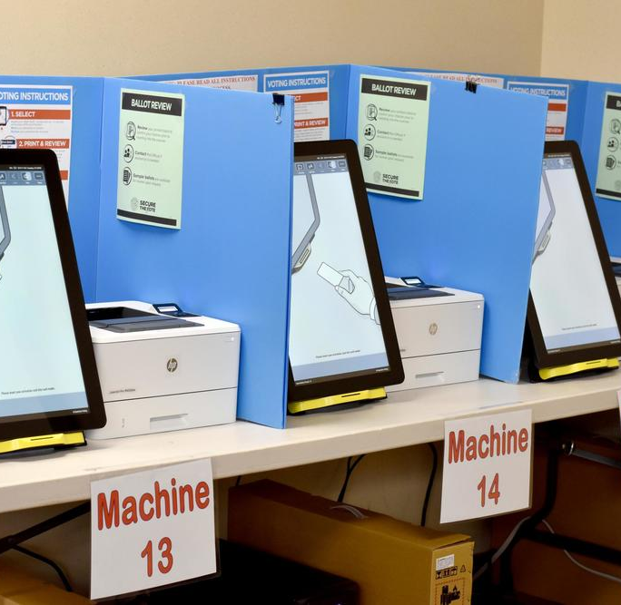
2S.B. 1 (Hughes/Murr) Election Code – Election Integrity: this bill, known as the Election Integrity Protection Act of 2021, makes numerous changes to state election laws. Of particular significance to cities and city elections, the bill, among other things:
establishes the intent of the legislature that the application of the Texas Election Code and the conduct of elections be uniform and consistent throughout the state to reduce the likelihood of fraud in the conduct of elections, protect the secrecy of the ballot, promote voter access, and ensure that all legally cast ballots are counted;
requires the governing body of a political subdivision to declare each unopposed candidate elected to office upon receipt of the certification of unopposed status;
prohibits a voter from casting a vote from inside a motor vehicle unless the voter is physically unable to enter a polling place;
requires, immediately before opening the polls for voting on the first day of early voting and on election day, the presiding election judge or alternate judge to confirm that each voting machine has any public counter reset to zero and must print the tape that shows the counter was set to zero for each candidate and measure on the ballot;
requires, immediately after closing the polls for voting on the last day of the election period, the presiding election judge or alternate judge to print the tape to show the number of votes cast for each candidate or ballot measure for each voting machine;
provides that, for elections in which the city secretary is the early voting clerk, early voting by personal appearance at the main early voting polling place shall be conducted at least nine hours each weekday of the early voting period that is not a legal state holiday, unless the territory covered by the election has fewer than 1,000 registered voters, in which case the voting shall be conducted at least four hours each day;

Slide 35
2S.B. 1 (Hughes/Murr) Election Code – Election Integrity Continued….
7. provides that a voter who has not voted before the scheduled time for closing a polling place is entitled to vote after that time if the voter is in line at the polling place by closing time;
8. provides that, for elections in which the city secretary is the early voting clerk, the authority ordering an election may order early voting by personal appearance at the main early voting polling place to be conducted on one or more Saturdays or Sundays during the early voting period;
9. provides that a temporary branch polling place may be located at any place in the territory served by the early voting clerk and may be located inside any building as directed by the authority establishing the branch office, but the polling place may not be located in a movable structure in the general election for state and county officers, general primary election, or runoff primary election;
10.provides that the early voting ballot board consists of a presiding judge, an alternate presiding judge, and at least one other member;
11. requires the general custodian of election records in a county with a population of 100,000 or more to implement a video surveillance system that retains a record of all areas containing voted ballots and is made available to the public by a livestream;
12. prohibits a presiding judge from having an election watcher removed from the polling place for violating an election law, other than a violation of the Penal Code and certain other exceptions, unless the violation was observed by an election judge or clerk;

Slide 36
2S.B. 1 (Hughes/Murr) Election Code – Election Integrity Continued….
13. provides that an election officer commits a Class A misdemeanor if the officer intentionally or knowingly refuses to accept a watcher for service when acceptance of the watcher is required by the Election Code;
14. authorizes an election watcher to observe all election activities relating to closing the polling place, including the sealing and transfer of a memory card, flash drive, hard drive, data storage device, or other medium now existing or later developed used by the voting system equipment;
15. entitles an election watcher to follow the transfer of election materials from the polling place at which the watcher was accepted to a regional tabulating center, central counting station, or any other location designated to process election materials;
16. generally provides that a written letter, e-mail, or other communication, including a communication made confidential by other law, between a public official and a voting systems vendor, is not confidential or subject to an exception to disclosure under the Public Information Act;
17. generally prohibits an officer or employee of a political subdivision from: (a) distributing an application form for an early voting ballot to a person who did not request an application; and (b) using public funds to facilitate the distribution by another person of an application form for an early voting ballot to a person who did not request an application;

Slide 37
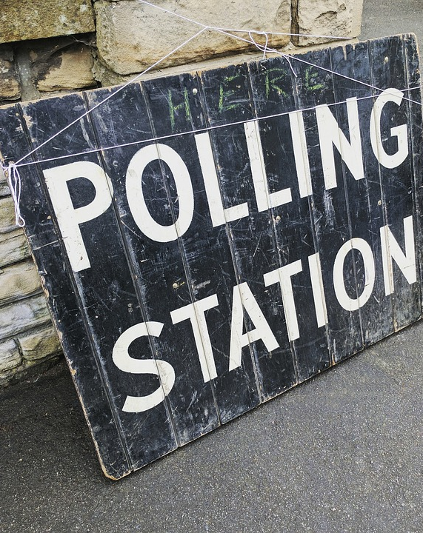
2S.B. 1 (Hughes/Murr) Election Code – Election Integrity Continued….
18. imposes requirements on the signature verification committee and early voting ballot board to give would-be voters an opportunity to cure certain defects regarding an early voting mail ballot;
19. provides that an election judge commits a state jail felony if the judge knowingly provides a voter with a form for an affidavit stating that the voter is the person on the list of registered voters if the form contains information that the judge entered on the form knowing it was false;
20. provides that a public official or election official commits a state jail felony if the official, while acting in an official capacity, knowingly: (a) solicits the submission of an application to vote by mail from a person who did not request an application; (b) distributes an application to vote by mail to a person who did not request the application unless the distribution is expressly authorized by another Election Code provision; (c) authorizes or approves the expenditure of public funds to facilitate third-party distribution of an application to vote by mail to a person who did not request the application; or (d) completes any portion of an application to vote by mail and distributes the application to an applicant;

Slide 38
2S.B. 1 (Hughes/Murr) Election Code – Election Integrity Continued….
21. prohibits a public official from creating, altering, modifying, waiving, or suspending any election standard, practice, or procedure in a manner not expressly authorized by the Election Code;
22. prohibits a person from serving as an election official if the person has been finally convicted under an offense under the Election Code; and
23. provides that an election official who violates the Election Code may be liable to the state for a civil penalty, which may include termination of the person’s employment and loss of the person’s employment benefits.
(Effective December 3, 2021.)

Slide 39
2S.B. 13 (Huffman/Hunter) Elections Code § 41.0075 – 2022 Primary Election Dates: provides that, among other things: (1) if a redistricting plan adopted following the 2020 federal census by the legislature that includes a State Board of Education, state legislative, or federal congressional district becomes law: (a) on or before November 15, 2021, the following dates related to the primary election for the election of officers for the district shall apply: (i) the general primary election date is March 1, 2022; and (ii) the runoff primary election date is May 24, 2022; (b) after November 15, 2021 and before December 28, 2021, the following dates related to the primary election for the election of officers for the district shall apply: (i) the general primary election date is April 5, 2022; and (ii) the runoff primary election date is June 21, 2022; and (c) after December 28, 2021 and on or before February 7, 2022, the following dates related to the primary election for the election of officers for the district shall apply: (i) the general primary election date is May 24, 2022; and (ii) the runoff primary election date is July 26, 2022; (2) if a redistricting plan has not become law on or before February 7, 2022, the secretary of state shall set the dates of the filing period and the general and runoff primary elections. (Effective immediately.)

Slide 40
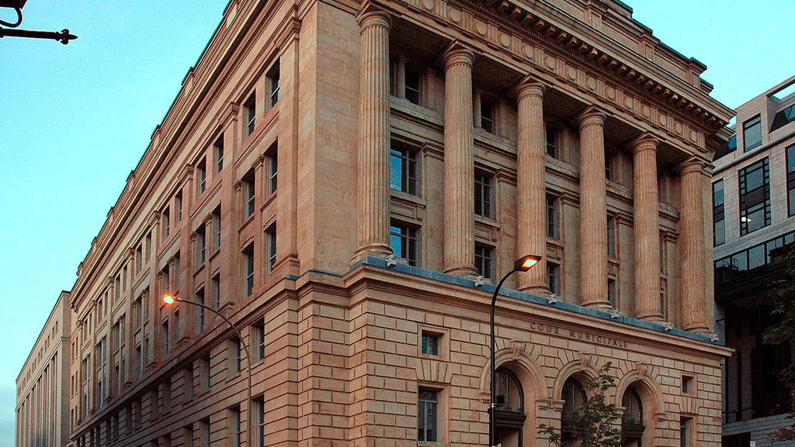
Municipal Courts

Slide 41
H.B. 569 (Sanford/West) Code of Criminal Procedure – Misdemeanor Fines: provides, among other things, that in imposing a fine and costs in a case involving a misdemeanor punishable by a fine only, the justice or judge shall credit the defendant for any time the defendant was confined in jail or prison while serving a sentence for another offense at a rate of $150 for each day of confinement if that confinement occurred after the commission of the misdemeanor. (Effective September 1, 2021.)

Slide 42
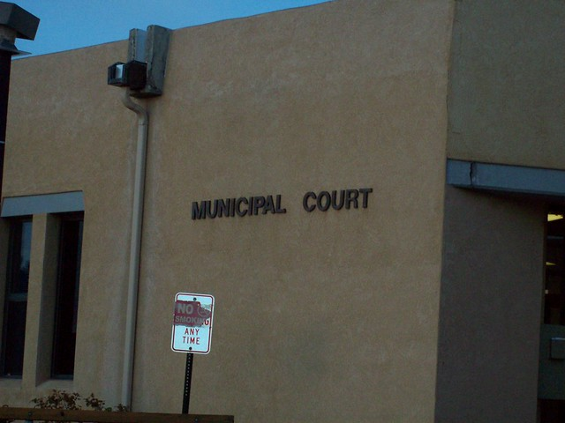
H.B. 3774 (Leach/Huffman) Code of Criminal Procedure – Municipal Court Pleas: provides, among many other things, that: (1) a judge may not accept a plea of guilty or plea of nolo contendere from a defendant in open court unless it appears to the judge that the defendant is mentally competent and the plea is free and voluntary; (2) the Texas Forensic Science Commission (commission) must adopt a code of professional responsibility and rules establishing sanctions for code violations to regulate the conduct of persons, laboratories, facilities, and other entities regulated by the state; (3) the commission is authorized to initiate an investigation of a forensic analysis or a forensic examination or test not subject to accreditation without receiving a complaint (former state law allowed for educational purposes); (4) a “forensic analyst” or “forensic science expert” is a professional service subject to the Professional Services Procurement Act; and (5) a “protective order” is defined to include an order issued by a court in this state to prevent sexual assault or abuse, stalking, trafficking, or other harm to an applicant. (Effective September 1, 2021, except that certain provisions creating new judicial district or statutory county courts have special effective dates.)

Slide 43
S.B. 41 (Zaffirini/Leach) Local Government Code – Court Costs: this bill consolidates, allocates and increases certain state civil court costs to be used for the following: (1) to support a statewide electronic filing technology project for courts in this state; (2) to provide grants to counties to implement components of the project; or (3) to support court technology projects that have a statewide impact as determined by the office of court administration. (Effective January 1, 2022.)

Slide 44
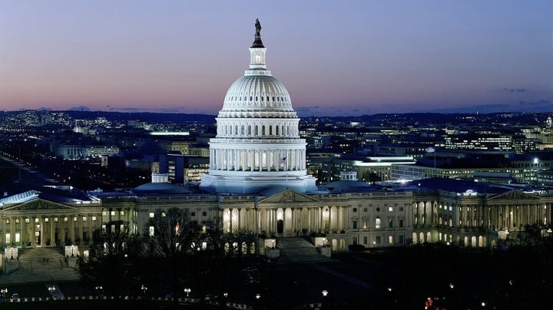
Open Government

Slide 45
H.B. 872 (Bernal/Menéndez) Government Code § 552.1331 – Confidentiality of Government-Operated Utility Customer Information: this bill provides that: (1) information is excepted from disclosure under the Public Information Act if it is information maintained by a government-operated utility that: (a) discloses whether services have been discontinued, or reveals whether an account is delinquent or eligible for disconnection by the government-operated utility; or (b) is collected as part of an advanced metering system for usage, services, and billing, including amounts billed or collected for utility usage, except that all such information is to be made available to that customer or their designated representative if the information directly relates to utility services provided to the customer and is not confidential under law; (2) a government-operated utility may not disclose personal and utility usage information for government operated utility customers unless the customer requests that the government-operated utility disclose such information on an appropriately marked form or other written request for disclosure (Note: former law made personal information and utility usage information confidential only if the customer elected to keep the information confidential on a form provided by the government-operated utility); and (3) a government-operated utility must provide notice of the customer’s right to request disclosure of personal and utility usage information, along with the form to elect for disclosure, in each customer’s utility bill or on the government-operated utility’s website. (Effective immediately.)

Slide 46
H.B. 1082 (P. King/Zaffirini) Government Code – Public Information: provides that: (1) with regard to information a city holds as an employer, the home address, home telephone number, emergency contact information, social security number, and personal family information of an elected public officer, is excepted from the Public Information Act, regardless of whether the elected officer complies with certain requirements to elect the information be kept confidential; (2) with regard to information contained in records maintained by the city in any capacity, an elected public officer’s home address, home telephone number, emergency contact information, date of birth, social security number, and family member information is excepted from the Public Information Act if the elected officer elects to keep the information confidential; and (3) elected public officers are added to the list of individuals who may choose to restrict public access to certain information in appraisal records. (Effective immediately.)

Slide 47
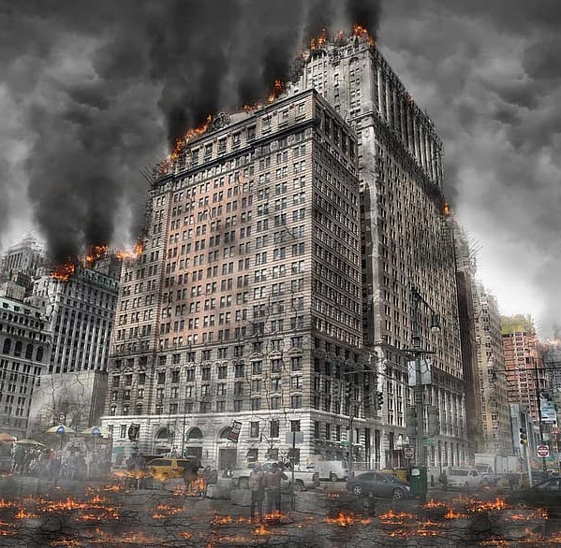
S.B. 1225 (Huffman/Paddie) Government Code – Temporary Suspension of TPIA: this bill, among other things, provides that: (1) for purposes of suspending the requirements of the Texas Public Information Act (TPIA), during a catastrophe, the term “catastrophe” does not mean a period when staff is required to work remotely and can access information responsive to an application for information electronically, but the physical office of the governmental body is closed; (2) a governmental body may suspend the requirements of the TPIA only once for each catastrophe; (3) a governmental body may suspend the requirements of the TPIA if the governmental body is currently significantly impacted by a catastrophe such that the catastrophe directly causes the inability of a governmental body to comply with the TPIA; (4) a governmental body that initiates a suspension period may not initiate another suspension period related to the same catastrophe, except for a single extension period, and that the combined suspension period for a governmental body may not exceed a total of 14 consecutive calendar days with respect to any single catastrophe; (5) if a governmental body closes its physical offices, but requires staff to work, including remotely, then the governmental body shall make a good faith effort to continue responding to applications for public information, to the extent staff have access to public information responsive to an application, while its administrative offices are closed; and (6) failure to respond to requests in accordance with (5), above, may constitute a refusal to request an attorney general's decision or a refusal to supply public information or information that the attorney general has determined is public information that is not excepted from required disclosure. (Effective September 1, 2021.)

Slide 48
OTHER FINANCE AND ADMINISTRATION BILLS

Slide 49
H.B. 29 (Swanson/Hughes) Government Code – Temporary Weapon Storage: this bill: (1) allows a political subdivision to provide a person temporary secure weapon storage when entering a building or portion of a building used by the political subdivision that is generally open to the public and in which carrying a firearm, knife, club or other weapon is prohibited by state law or the political subdivision; (2) allows weapon storage to be provided via self-service weapon lockers or other temporary secure weapon storage operated at all times by a designated employee of the political subdivision; (3) allows a political subdivision to collect a fee of not more than $5 for the use of a self-service weapon locker or other temporary secure weapon storage; and (4) addresses how a political subdivision must handle an unclaimed weapon. (Effective September 1, 2021.)

Slide 50
H.B. 604 (Noble/Zaffirini) Health & Safety Code – Animal Shelter: requires that, as soon as practicable after an animal is placed in the custody of an animal shelter, the shelter scan the animal to determine whether a microchip is implanted in the animal. (Effective September 1, 2021.)
H.B. 3340 (Swanson/Bettencourt) Health & Safety – Dangerous Dogs: this bill provides that: (1) any order to destroy a dog is stayed for a period of ten calendar days from the date the order is issued, during which period the dog’s owner may file a notice of appeal; and (2) a court, including a justice court, may not order the destruction of a dog during the pendency of an appeal related to a dangerous dog, including an order to destroy a dangerous dog and an order determining that a dog is a dangerous dog. (Effective September 1, 2021.)

Slide 51
S.B. 617 (Kolkhorst/Wilson) Health & Safety Code – Farmers’ Markets: this bill: (1) provides that a permit issued to a farmer or food producer for the sale of food directly to consumers: (a) must be valid for a term of not less than one year; (b) may impose an annual fee in an amount not to exceed $100 for the issuance or renewal; and (c) must cover sales at all locations the holder is authorized to sell food, including farmers’ markets, farm stands, and farms; and (2) creates a cause of action for a farmer or food producer whose permit does not comply with (1) to recover: (a) the amount the farmer or food producer was charged in excess of the annual fee; and (b) reasonable and necessary attorney’s fees. (Effective September 1, 2021.)

Slide 52
PERSONNEL

Slide 53
S.B. 45 (Zaffirini/Zwiener) Labor Code – Sexual Harassment: provides that an employer commits an unlawful employment practice if sexual harassment of an employee occurs and the employer or the employer’s agents or supervisors: (1) know or should have known that the conduct constituting sexual harassment was occurring; and (2) fail to take immediate and appropriate corrective action. (Effective September 1, 2021.)

Slide 54
H.B. 1589 (Davis/Menéndez) Government Code § 437.202 – Paid Military Leave: provides that: (1) a person who is an officer or employee of the state, a city, a county, or another political subdivision and who is a member of the Texas military forces, a reserve component of the armed forces, or a member of a state or federally authorized urban search and rescue team is entitled to paid leave of absence for each day the person is called to state active duty by the governor or another appropriate authority in response to a disaster, not to exceed seven workdays in a fiscal year; and (2) during the leave of absence described in (1), the person may not be subjected to loss of time, efficiency rating, personal time, sick leave, or vacation time. (Effective September 1, 2021.)

Slide 55
H.B. 2073 (Burrows/Springer) Local Government Code – Paid Quarantine Leave: provides that: (1) the governing body of a political subdivision, including a city, shall develop and implement a paid quarantine leave policy for fire fighters, peace officers, detention officers, and emergency medical technicians who are employed by, appointed by, or elected for the political subdivision and ordered to quarantine or isolate due to a possible or known exposure to a communicable disease while on duty; (2) a paid quarantine leave policy must: (a) provide that a fire fighter, peace officer, detention officer, or emergency medical technician on paid quarantine leave receives: (i) all employment benefits and compensation, including leave accrual, pension benefits, and health benefit plan benefits for the duration of the leave; and (ii) reimbursement for reasonable costs related to the quarantine, including lodging, medical, and transportation; and (b) require that the leave be ordered by the person’s supervisor or the political subdivision’s health authority; and (3) a political subdivision may not reduce a fire fighter’s, peace officer’s, detention officer’s, or emergency medical technician’s sick leave balance, vacation leave balance, holiday leave balance, or other paid leave balance in connection with paid quarantine leave taken in accordance with a policy adopted (1). (Effective immediately.)

Slide 56
S.B. 1359 (Hughes/White) Government Code Adding Chapter 614 – Mental Health Leave Policy: provides among other things, that: (1) each law enforcement agency shall develop and adopt a policy allowing the use of mental health leave by peace officers employed by the agency who experience a traumatic event in the scope of that employment; and (2) the policy adopted under (1) must: (a) provide clear and objective guidelines establishing the circumstances under which a peace officer is granted mental health leave and may use mental health leave; (b) entitle a peace officer to mental health leave without a deduction in salary or other compensation; (c) enumerate the number of mental health leave days available to a peace officer; and (d) detail the level of anonymity for a peace officer who takes mental health leave. (Effective September 1, 2021.)

Slide 57
TRANSPORTATION

Slide 58
H.B. 1281 (Wilson/Schwertner) Transportation Code § 551.403– Golf Carts: this bill: (1) allows a golf cart to be operated in a master planned community: (a) that is a residential subdivision or has in place a uniform set of restrictive covenants; and (b) for which a county or city has approved one or more plats; (2) provides that a person may operate a golf cart in a master planned community described in (1) without a golf cart license plate on a highway for which the posted speed limit is not more than 35 miles per hour, including through an intersection of a highway for which the posted speed limit is more than 35 miles per hour; (3) allows a golf cart to be operated on a highway for which the posted speed limit is not more than 35 miles per hour, if the golf cart is operated during the daytime and not more than five miles from the location where the golf cart is usually parked and for transportation to or from a golf course; (4) allows a city to prohibit the operation of a golf cart on a highway in the following areas if the city council determines the prohibition is necessary in the interest of safety: (a) in a master planned community described in (1), above; (b) on a public or private beach that is open to vehicular traffic; or (c) on a highway for which the posted speed limit is not more than 35 miles per hour as described in (2), above. (Effective immediately.)

Slide 59
H.B. 914 (Hernandez/Huffman) Occupations code § 2308.354 – Parking: allows: (1) a city to authorize a city employee to request the removal and storage of a vehicle in an area where on-street parking is regulated by an ordinance and that: (a) is parked illegally; or (b) is parked legally, but has been unattended for more than 48 hours and is reasonably believed to be abandoned; and (2) a parking facility owner or towing company to remove a vehicle from a public roadway under the direction of a city employee authorized to make a request under (1). (Effective September 1, 2021.)

Slide 60
UTILITIES AND ENVIRONMENT

Slide 61
H.B. 837 (Lucio III/Zaffirini) Water Code – Certificates of Convenience and Necessity: provides that the Public Utility Commission by rule shall require a city or franchised utility to submit a report to the PUC verifying that the city or franchised utility has paid all required adequate and just compensation to a retail public utility for obtaining the certificate of convenience and necessity for an annexed area previously served by the retail public utility. (Effective September 1, 2021.)

Slide 62
Questions?
Clarissa M. Rodriguez cmrodriguez@rampagelaw.com
Denton Navarro Rocha Bernal & Zech, P.C. 2517 N. Main San Antonio, TX 78212 (210) 227-3243

