Slide 1
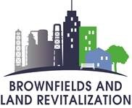
Brownfields 101
An introduction to Brownfields and understanding the benefits of the Brownfields Program for your community

Slide 2
A Brownfield Is…
Real property, the expansion, redevelopment or reuse of a site may be complicated by the presence or potential presence of hazardous substance, pollutant, or contaminant.
Notes:
This is the official definition of a Brownfields. is Real property, the expansion, redevelopment or reuse of a site. A site that may be complicated by the presence or potential presence of hazardous substance, pollutant, or contaminant.

Slide 3
Potential Impacts of Brownfields
Economic
Decreased property values and city tax revenues
Environmental
Potential threats to human health and the environment
Social
Increased urban sprawl and inner-city blight

Slide 4
Brownfields occur throughout the United States
There is approximately 450,000 brownfields sites throughout the United States
Notes:
Brownfields occur throughout the United States in both urban and rural areas.
The link located on this slide, is a great place to get started is on EPAs webpage for Brownfields and Land Revitalization in Region 6 where you will find material for Brownfield grants, stories from around the region and your state Cleanup programs. The link is also referenced in the last slide.

Slide 5
Brownfield Site Examples
Notes:
Next we will go to Brownfields Site Examples.

Slide 6
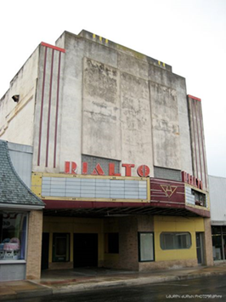
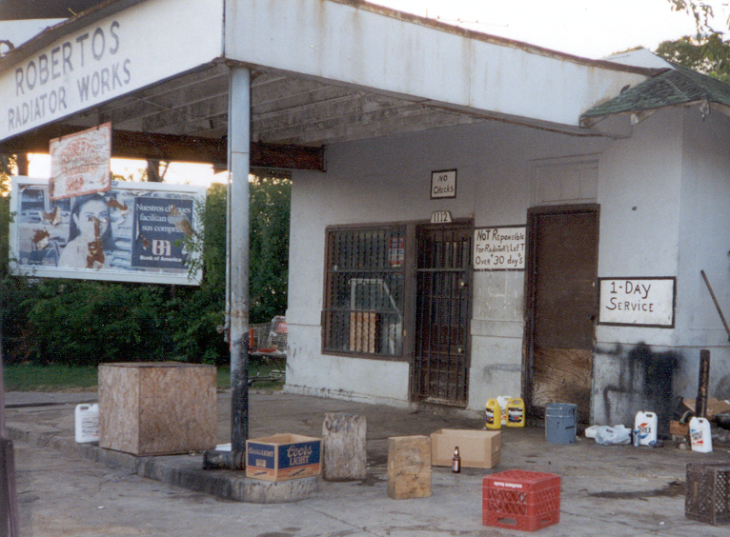
Examples of Brownfields
Notes:
Some examples of Brownfields are Abandoned or dilapidated buildings like gas stations, automotive shops and movie theaters.

Slide 7
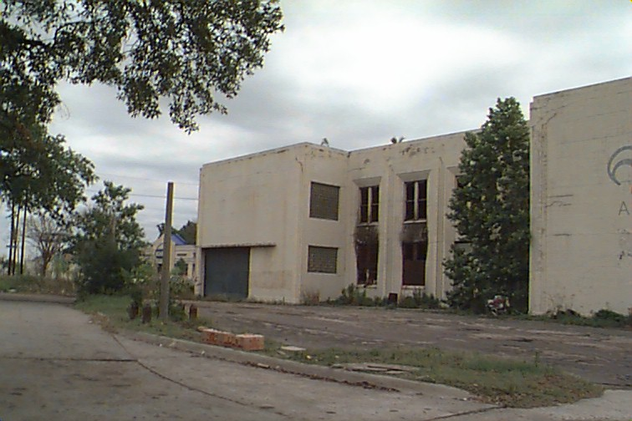
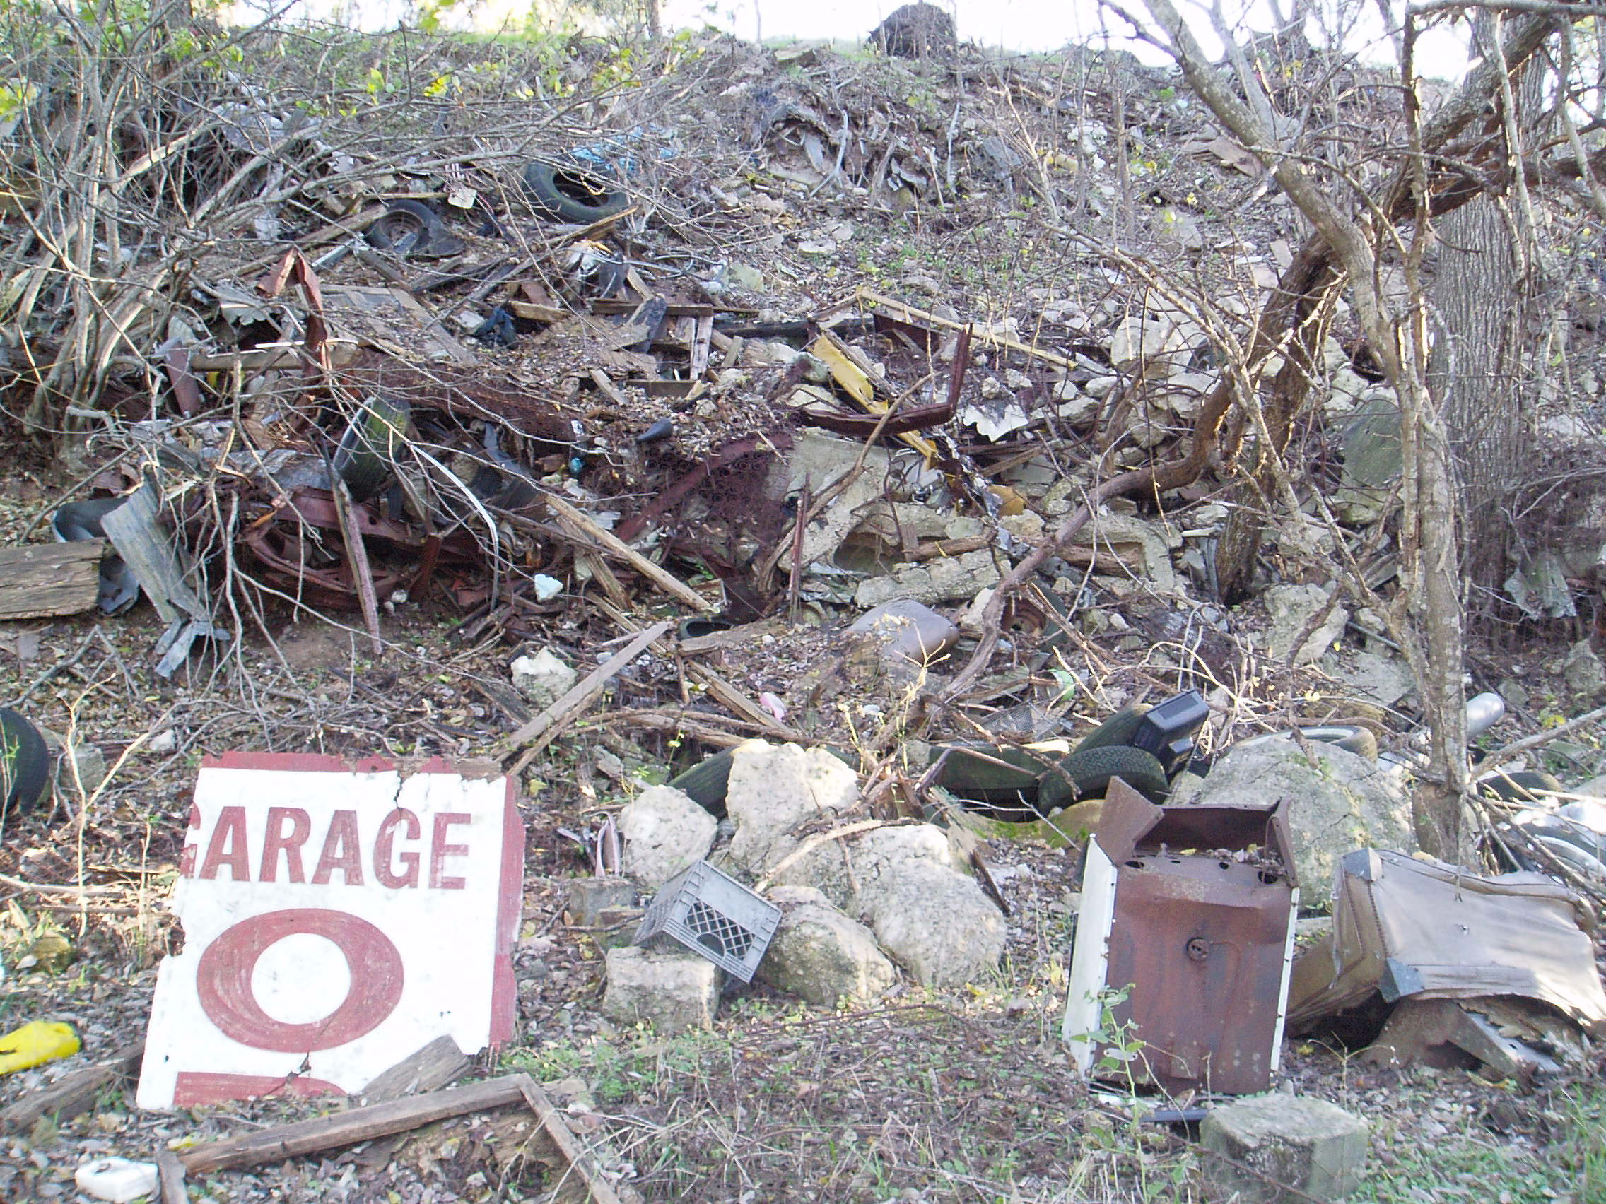
Examples of Brownfields
Notes:
Other examples of Brownfields can include - Illegal dump sites, abandoned industrial or can be medical facility, or an abandoned school
Manufacturing and warehouse- keeping in mind the possible presence of hazardous substances

Slide 8
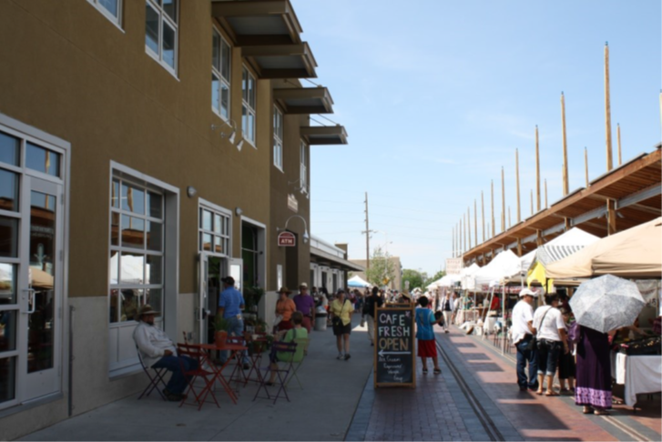
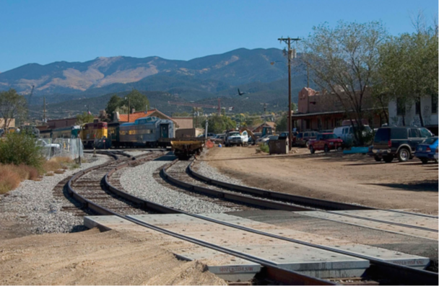
Brownfields Site in New Mexico Former Railyard Turned Art District
Old Santa Fe Railyard Santa Fe,
New Mexico
Notes:
Here is a Brownfields Site in New Mexico which was a formerly a 50-Acre Railyard in downtown Santa Fe, NM and now thru Brownfields Assessment Pilot Grant is now turned into an Art District and this project started in FY96 and completed in 2001.
Assessment grant went to cleanup studies, partnerships, community outreach and removing barriers to redevelopment.
TBA went to identify contaminants in the soil and ground water- (thru Phase I and Phase II ESAs).
Cleanup was done thru partnership with New Mexico Environment Dept. (NMED) Voluntary Cleanup program- NMED issued their certificate of completion in 2006.

Slide 9
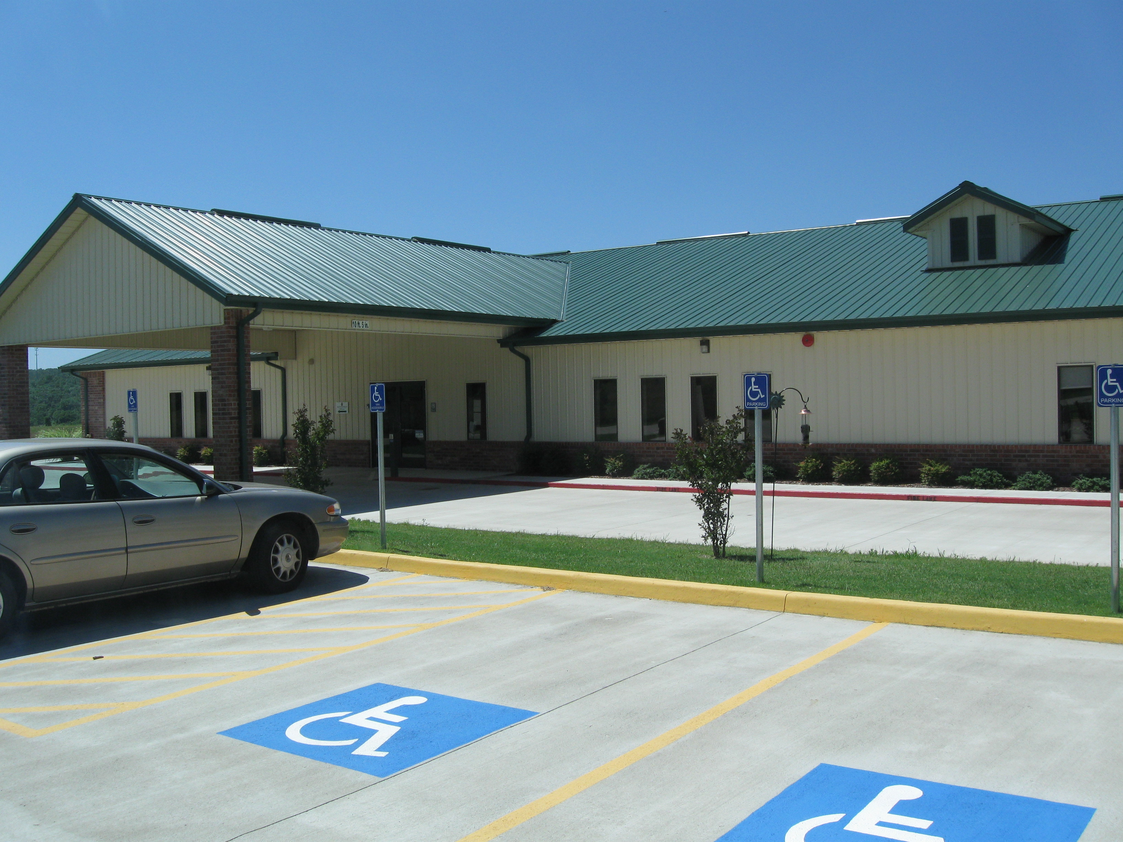
Brownfields States and Tribal Technical Assistance Program, OK
Inter-Tribal Environmental Council
(ITEC) & Cherokee Nation
Markoma, Oklahoma
Notes:
Received the non-competitive State and Tribal Assistance Grant in 2005
Target Area: Nearly 119-acres consisting of an old High School and surrounding areas
Purpose of Funding was used to assess and remediate hazardous substances. Converting the site into a multipurpose Tribal medical, health and fitness center.

Slide 10
Brainstorm!
Potential sites in your communities
Environmental issues affecting your communities
Notes:
Let’s Brainstorm!
Looking at these sites, did you come to recognize similar sites within your community.
If you are not collaborating with your community partners or other stakeholders, right now would be a great time to start involving your community with potential Brownfields sites, this is the time to start looking around and look for abandoned gas stations, dry-cleaners, vacant building etc. so now you start an inventory of your sites.
Nod your head if this sounds familiar to you.

Slide 11
Brownfields Project Process
1. Identify site
2. Assess
3. Clean up
4. Redevelop
Notes:
I will discuss the four steps of the Brownfields Project Process which includes 1) Identify the site 2)Assess the Site thru Phase I and Phase Environmental Site Assessments and after you assessed it you clean it up and you redeveloped as in this picture of the American Airlines Center which used to be a smelter power plant now located in Victory park in Dallas, Texas.

Slide 12
Elements of Brownfields Revitalization
Determine reuse and vision goals
Identify Brownfield sites
Conduct Environmental Assessments
Prioritize Brownfields
Leverage Funding Resources
Clean Up and Revitalize
Local Stakeholders
RLF and/or Clean up Grants
Assessment grants
Notes:
Local stakeholders are involved throughout all the elements of brownfields revitalization.
The Process-To accomplish these steps your goal should be identifying and assessing the needs of your community and doing so you will be identifying potential Brownfields Sites and prioritizing the projects that will provide environmental relief and benefits of your community. The process includes envisioning the goals that fit the community needs; Inventory potential brownfield sites (remember the examples; abandoned gas stations, movie theaters, dilapidated buildings, etc.)
Prioritize the sites from the brownfields inventory by feasibility and importance.
All steps are needed for successful revitalization—not a step-by-step recipe, this work is continuous, but the result improves the community and local environment in many ways.

Slide 13
How does the EPA Brownfields program work?
Part of the program is Grant based and includes funding for State & Tribal Programs
Targeted Brownfields Assessments (TBA)—funding to assist a community on one or more sites though the State/Tribal/EPA program
Notes:
Grants are provided competitively to communities and eligible organizations along with state and tribal funding.
There are also technical assistance programs to help fill the gaps for those who were not fortunate to receive a grant.
Targeted Brownfields Assessments
Technical Assistance to Brownfields
(More information about Technical Assistance programs in later slides)

Slide 14
Benefits of the Brownfields Program
Revitalize communities
Create jobs and increase local revenue
Revitalize urban areas
Protect the environment by the use of greenspaces
Examples of Green Spaces are Parks, playgrounds
Community Health- by improving Walkability and neighborllness while at the same time decreases crime
Projects leveraged $20 per EPA dollar expended
Leveraged 170,000 jobs nationwide
Residential property values increase by 5% to 15% when brownfield sites are cleaned up.

Slide 15
Brownfields Assistance and Funding Opportunities
Assessment Grants
Clean Up Grants
Revolving Loan Funds
State Response Programs
Targeted Brownfields Assessment (TBA)
Job Training Grants
Multipurpose Grant
Notes:
Briefly name the various funding opportunities provided. Note the variety and number of opportunities.
Please note - A solicitation for new Multipurpose Grants will not be available in FY22. EPA expects to solicit requests for Multipurpose Grant funding in FY23. Multipurpose Grants are available every other year.

Slide 16
Brownfields Assistance Opportunities – Eligible Applicants
Regional Councils of Government
Cities
Redevelopment Agencies
States
Non-profit organizations
Local Governments
Tribes
Notes:
This is a good, simple guide on who/what is eligible for funding.

Slide 17
Brownfields Assistance – Potential Contaminants
Mine scarred lands
Petroleum Products
Contaminants
Illegal drug labs
Pollutants
Lead based paint
Asbestos
Hazardous Substances
Notes:
Potential contaminants takes many forms:
Mine Scarred Lands – Fracking or when you dig for oil used salt and there is salt on the ground.
Petroleum Products – Crude oil, underground storage tanks
Contaminants can be substances that can cause cancer (Carcinogen)
Meth Labs are illegal drug labs and were added to Brownfields a few years ago.
Pollutants – Carbon Monoxide is odorless, and invisible
Lead based paint – Causes mental issues if ingested by kids.
Asbestos was used in many forms in the 50’s for floor adhesive (Mastic) and insulation.
Hazardous Substances can be abandoned unmarked 55-gallon drums.

Slide 18
Not Eligible for Brownfields Assistance – Applicants and Contaminants
Applicants
Potentially Liable Parties
Private owners/developers
Contaminants
Sites listed on National Priorities List
Sites subject to CERCLA order
Sites subject to the control of the federal government
Notes:
This is a list of ineligible entities for Brownfields funding
Cannot give grants to Potentially Liable Parties or Private owners—not in the business of giving tax-payer money to the ones potentially responsible for the contamination (can do assessments by proxy with the knowledge these parties are potentially liable for the cleanup)

Slide 19
When to Conduct an All Appropriate Inquiry/Phase I ESA
BEFORE acquiring the property
Conducted or updated within 1 Year PRIOR to the acquisition of the property
Update within 180 days prior to the acquisition
Notes:
Phase I Environmental Site Assessment is a record review of the site (current and past owners, current and past uses) and a site visit. This helps to determine the potential contamination/s.
When to conduct an All-Appropriate Inquiry/ Phase I Environmental Site Assessment:
1 year prior to the acquisition of the property
If needed, an updated Phase I Environmental Site Assessment 180 days prior to the acquisition.

Slide 20
GRANTS
Notes:
Next, we will talk about the different grant types

Slide 21
Assessment Grant
Up to $500,000
Up to 50% of funds can be used for planning
Three-year project period
No coalitions in 2022
States and Tribes can apply for an Assessment Grant up to $2 million (limited awards will be made)
Notes:
FY22 Change
Given the thoughtful questions EPA received on eligibility in response to previously released guidance, EPA has decided not to employ the Assessment Coalition Grant approach in FY22. It has become evident that it will be challenging to fairly and effectively communicate which entities would be eligible for funding and to make accurate eligibility determinations consistently given the variations in state and local laws.
Therefore, EPA will not solicit requests for Assessment Coalition Grant funding in the upcoming competition cycle. We apologize for any inconvenience this decision may cause. We encourage entities that planned to apply for an Assessment Coalition Grant to apply for a Community-wide Assessment Grant (now up to $500,000) as there may be opportunities to partner with other eligible entities.
3 year performance period
There are no coalitions in 2022
Developing a inventory of Brownfield sites, conducting community involvement activities, Phase 1 & 2 Environmental Site Assessments, Clean up reuse planning and developing area wide revitalization plans

Slide 22
Cleanup Grant
Up to $500,000
One or more sites
Three-year project period
Notes:
Clean up grants provide funding to eligible entities to carry out clean up activities
Applicant must be the sole owner of the sites prior to application. Applicant must have Phase 2 ESA completed
3-year performance
$500,000 to address 1 or more BF
Conducting community involvement activities
Have one or more applicant owned sites with clean-up potential.
Submit one Cleanup Grant proposal each competition cycle, along side with Analysis of Brownfields Cleanup Alternatives (ABCA) for each site.
Applicant have Phase 2 ESA complete

Slide 23
Revolving Loan Fund Grant
Provides up to $1,000,000
Can loan to public or private developers
Grantee determines loan terms
Five-year performance period
Notes:
Revolving Loan Fund is one of the more complex grants.
Can apply as an eligible individual entity or as an RLF Coalition comprised of two or more entities.
Nonprofits, LLCs and Non profit community development entities are eligible.
Eligible activities include cleanup, loan program implementation and confirmatory sampling only
Can provided funds up to a million dollars
can be loan to public or private developers
Grantee determines loan terms
5-year performance

Slide 24
Brownfields Grant Schedule
Applications are due December 1, 2021
FY 2022 Assessment Grants-
FY 2022 Revolving Loan Fund (RLF) Grants
FY 2022 Cleanup Grants
Announced usually May/June
Awarded by October (next FY)
Notes:
Read Slide
Guidelines are currently out as of September 22,2021.
Deadlines to submit proposals in December 1, 2021.

Slide 25
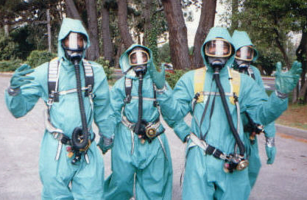
Job Training Grant
Conducts environmental training, allowing applicants to tailor the curriculum of their programs
OSHA 29 CFR 1910.120 40-hour HAZWOPER is the only required training.
Provides up to $200,000
Three-year Performance period
Notes:
The Environmental Workforce & Job Training Grant (EWDJT)…
Allow nonprofits, local gov, and other organization to recruit and train residents affected by the presence of a near BF.
40 Hour HAZWOPER is the only required training
Grant helps to conduct environmental training and tailoring through a curriculum program-
Funding can be up to $200,000
with a 3-year performance period and up to 5% used on admin cost

Slide 26
Brownfield Resources & Guides
Links
Types of Grant Funding
Solicitations for Brownfield Grants
EPA Brownfields 2019 Federal Programs Guide
EPA Region 6 Brownfields Program,
Region 6 National Competition Co-Leads.
Denise Williams - Assessments
Williams.denise@epa.gov
214-665-9749
Paul Johnson - Cleanups
Johnson.paul@epa.gov
214-665-2246
Camisha Scott – RLF & Job Training Grant
Scott.camisha@epa.gov
214-665-6755
Notes:
In this slide you find links to each funding types.
Also, please feel free to contact any leads for the type of grants that you are applying for.

Slide 27
Technical Assistance

Slide 28
Targeted Brownfields Assessments and State and Tribal Response Program
Targeted Brownfields Assessments (TBA)
Provided by EPA or State, at no cost to the applicant
Area-wide inventories
Phase I – Research
Phase II – Sampling
Phase III – Cleanup Planning
Available year-round, case-by-case basis, performed by service contractors and managed by EPA or State
State and Tribal Response Program
Funding is non-competitive
Awarded on an annual basis
Can also be used for limited site assessments or cleanups at brownfield sites
Purchase environmental insurance
Develop other insurance mechanisms for cleanup activities
Notes:
Read from slide: Highlight the TBA and how this TA can help fill the gaps of not having access to an assessment grant.
Briefly discuss the State and Tribal Response Program.

Slide 29
Links
Targeted Brownfields Assessments (TBA)
State and Tribal Response Program Grants
EPA Region 6 Brownfields Program,
Targeted Brownfields Assessments Lead
Roxanne Welch
Welch.Roxanne@epa.gov
214-665-2235
EPA Region 6 Brownfields Program
State/Tribal Coordinator for 128(a) Grant
Elizabeth Reyes
Reyes.Elizabeth@epa.gov
214-665-3163
Notes:
Contact Information –Please see contact information

Slide 30
Stay Tuned
National Brownfields Conference
Oklahoma City, Oklahoma
Notes:
The National Brownfields Conference has been postponed until 2022
They are planning a couple of Remote/Virtual engagements with you in December
Please stay tuned for details about upcoming virtual engagements and the dates for rescheduled of the conference.

Slide 31
References
EPA’s National Brownfields Website:
https://www.epa.gov/brownfields
EPA’s Region 6 Brownfields Website:
https://www.epa.gov/brownfields/brownfields-and-land-revitalization-texas-new-mexico-oklahoma-arkansas-and-louisiana
EPA Brownfield 101 Factsheets
https://www.epa.gov/brownfields/understanding-brownfields
Ana Esquivel
214.665.2194
Esquivel.ana@epa.gov
Notes:
Please let me know if you have any questions my contact information is on this slide.

