Slide 1
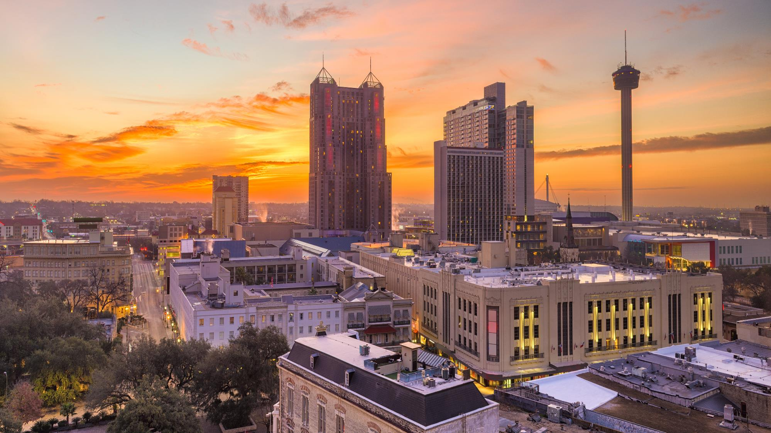
Energy Efficiency Programs for Local Governments and their Constituents
May 10, 2023
Notes:
Good morning and thank you for joining us this morning for our roundtable discussing energy efficiency programs for local governments and their constituents. We’re happy you could join us, welcome to those who have joined remotely.

Slide 2
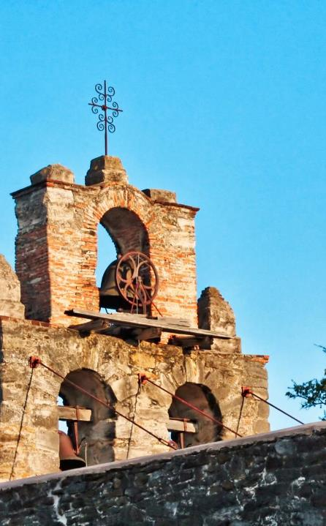



AGENDA
Programs for Constituents
Programs for Local Governments
Notes:
I’ve invited a couple of experts from the State Energy Conservation Office (SECO) to talk about LoanSTAR and other programs to help local governments lower their operating costs and energy usage. John Kyere (Cheeyery) and Adam Mueller (Myooler).

Slide 3

Innovative financing for commercial energy and water saving initiatives
PROPERTY
ASSESSED
CLEAN
ENERGY

Slide 4
What is TX-PACE?
• | Commercial, non-profit, industrial (manufacturing & agricultural), & multi-family (5+ units) properties – no greenfields
• | 100% long-term, low-cost private financing unlocked by assessment lien imposed on property
• | Energy efficiency, water conservation, distributed generation, and demand reduction
Alamo Area Council of Governments

Slide 5
What is TX-PACE?
• | Enacted in 2013 – Local Gov’t Code Chapter 399
• | Allowed cities and counties to create individual PACE programs within their jurisdictions
• | Cities and counties must adopt PACE within their boundaries for property owners to take advantage of it
• | Voluntary program requires no extra work with ILA
Alamo Area Council of Governments
Notes:
If a county adopts, then the cities within that county are already PACE-enabled

Slide 6
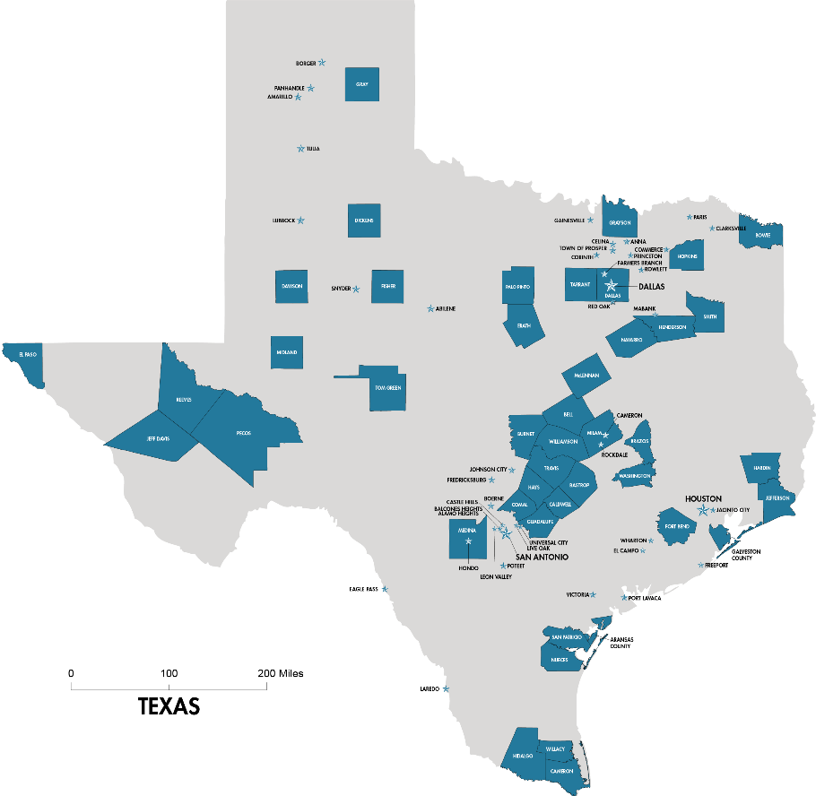
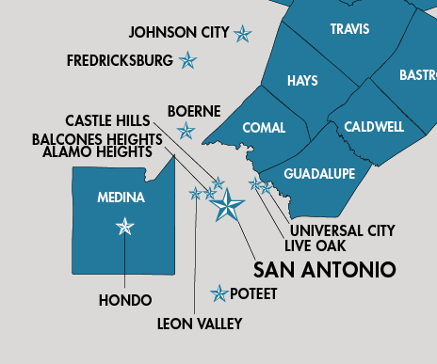
Where is TX-PACE?
In the AACOG Region:
  Alamo Heights
  Balcones Heights
  Boerne
  Castle Hills
  Fredericksburg
  Hondo
  Leon Valley
  Live Oak
  Poteet
  San Antonio
  Universal City
  Comal County
  Guadalupe County
  Medina County
Alamo Area Council of Governments
Notes:
87 cities and counties to date

Slide 7
Qualified Improvements
Chillers, Boilers, Furnaces | Toilets | Distributed Generation Systems
HVAC, BMS, EMS Controls | Faucets | Greywater Systems
Energy Management Systems | Pool Equipment | Elevator Modernization
Water Heating Systems | Cogeneration | Doors
Lighting | Water Management Systems | Insulation
Roofing | Rainwater Collection Systems | Solar Panels
Windows | Irrigation Equipment | Wind Turbines
Includes heavy duty industrial equipment permanently affixed to property
Alamo Area Council of Governments
Notes:
Qualified improvements must:
Be permanently fixed to the real property
Decrease water or energy consumption or demand
Includes renewables and distributed generation products on the customer’s side of the meter that use energy technology to generate electricity, provide thermal energy, or regulate temperature
Have a useful life that exceeds the term of the PACE financing agreement.

Slide 8
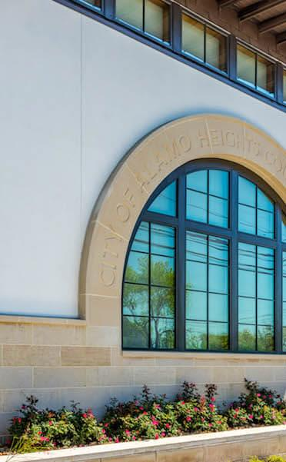
Why TX-PACE?
Local Governments
Property owners/occupants substantially save in utility costs
Reduce demand on electricity grid
Mitigate greenhouse gas emissions
Enhance value and efficiency of buildings
Support municipal & regional resiliency plans and sustainability goals

Slide 9
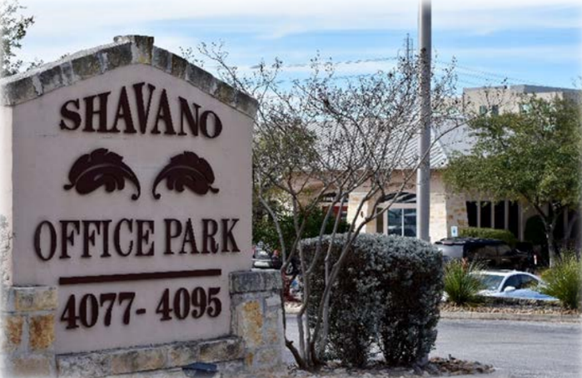
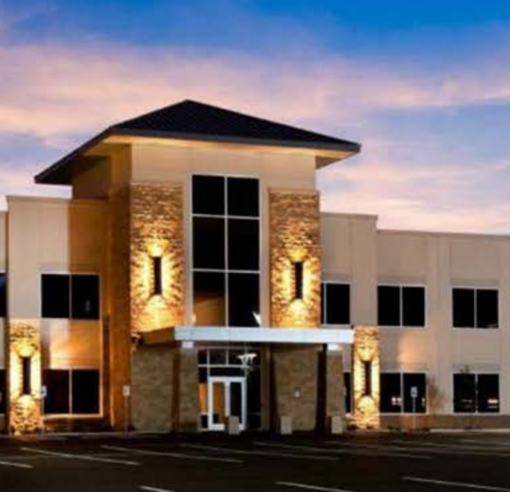
Risk Avoidance
Local Governments
Senior lien status
Utilize existing debt servicing upon default
No use of City funds or resources (ILA)
Free market, hands-off approach
Independent Third Party Review
Streamlined applications and documents ensure success (PACE in a Box)
Notes:
Free market approach utilizing private lender; AACOG will not give preference to any provider, but instead direct clients to a list of providers who have completed a Texas PACE training/certification

Slide 10
Steps to Adopt PACE
Meeting One
Meeting Two
  Publish Local PACE Program Report with Exhibits
  Resolution of Intent to Establish Local PACE Program
Hold a public hearing
Resolution to Establish Local PACE Program (include Report with Exhibits)
Approve ILA between Local Government and AACOG to administer program
Alamo Area Council of Governments
Action items in red

Slide 11

Contractual
Documents
Closing documents include:
  Owner and Local Government Contract – agrees to the assessment lien imposed on the property
  Capital Provider and Local Government Contract – assigns proceeds of assessment to capital provider
  Notice of Assessment Lien – AACOG will record notice of PACE assessment lien with county clerk
  Mortgagee Consent (if applicable)

Slide 12

PACE in a Box
A toolkit of recommendations and templates
for counties and municipalities
• | Create uniform, user-friendly, scalable, and sustainable PACE programs
• | Administered by a non-profit, in a transparent manner, focused on government tasks
• | Free market with decision/power in the hands of property owner
Alamo Area Council of Governments

Slide 13
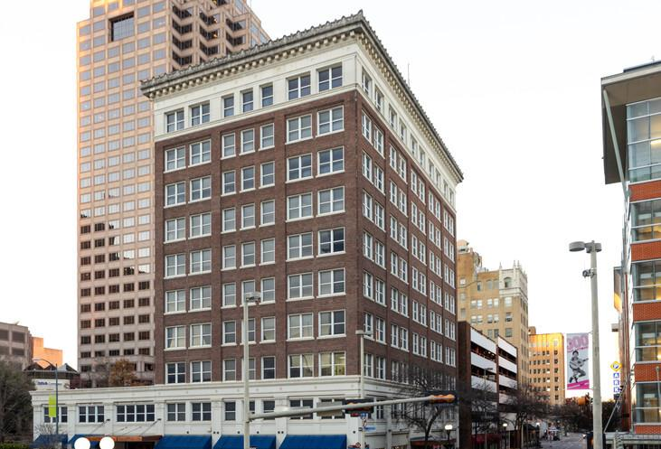
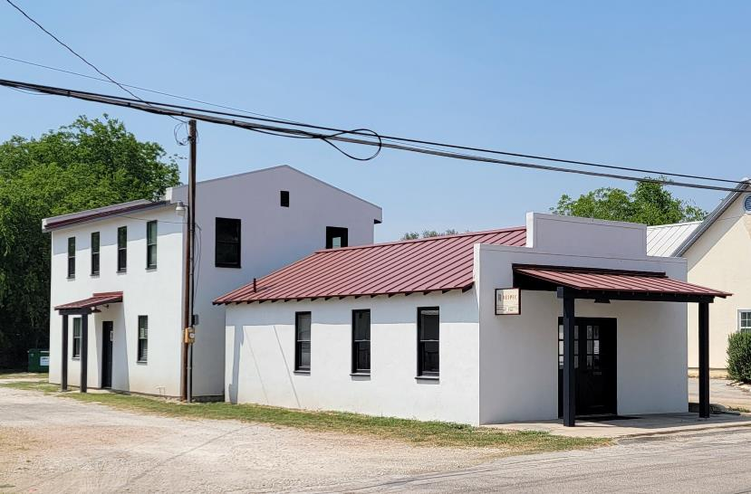
Local Case Studies
Travis Building | San Antonio, TX
Building envelope • Roof • Lighting • Plumbing • HVAC
Assessment: $5 million
Capital Provider: PACE Equity, LLC
Historic Post Office | Castroville, TX
Building envelope • LED Lighting • HVAC • Plumbing
Assessment: $145,000
Capital Provider: Inland Green Capital
Alamo Area Council of Governments

Slide 14
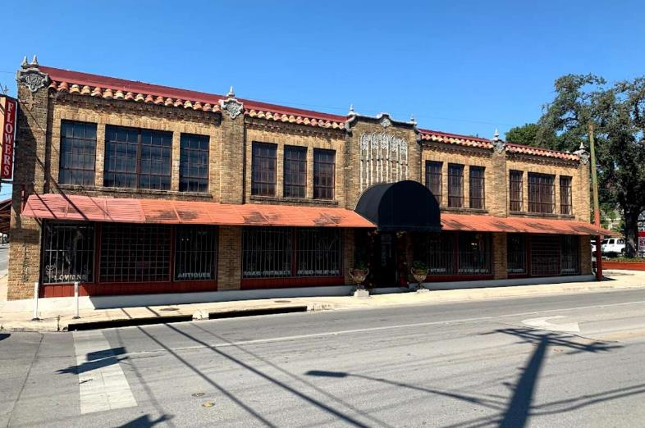
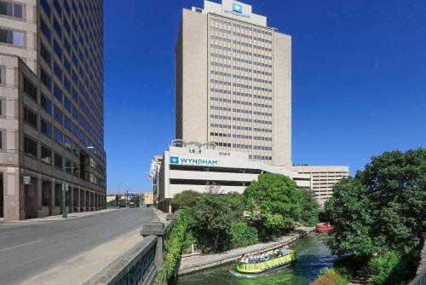
Local Case Studies
The Allen | San Antonio, TX
Envelope • LED Lighting • HVAC
Assessment: $1,559,719
Capital Provider: PACE Equity, LLC
Intercontinental Hotel | San Antonio, TX
Envelope • Plumbing • LED Lighting •
Water Conservation • HVAC
Assessment: $28 million
Capital Provider: Nuveen Green Capital
Alamo Area Council of Governments

Slide 15
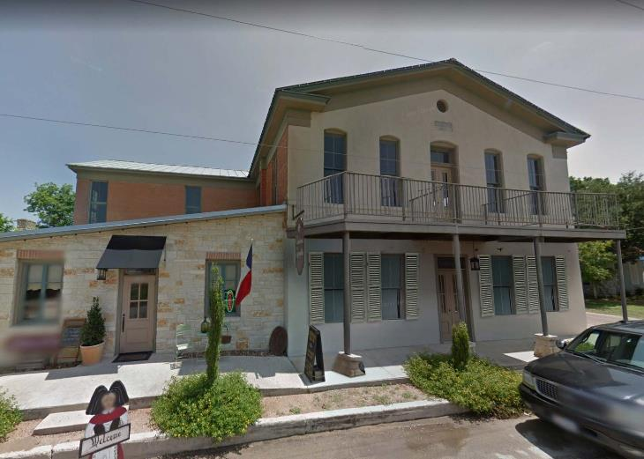
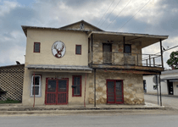
Local Case Studies
Elsass Hall | Castroville, TX
Envelope • LED Lighting • Plumbing •
Water Conservation • HVAC
Assessment: $390,000
1303 Lorenzo | Castroville, TX
Envelope • LED Lighting •
Water Conservation • HVAC
Assessment: $690,000
Alamo Area Council of Governments
Capital Provider: Inland Green Capital

Slide 16
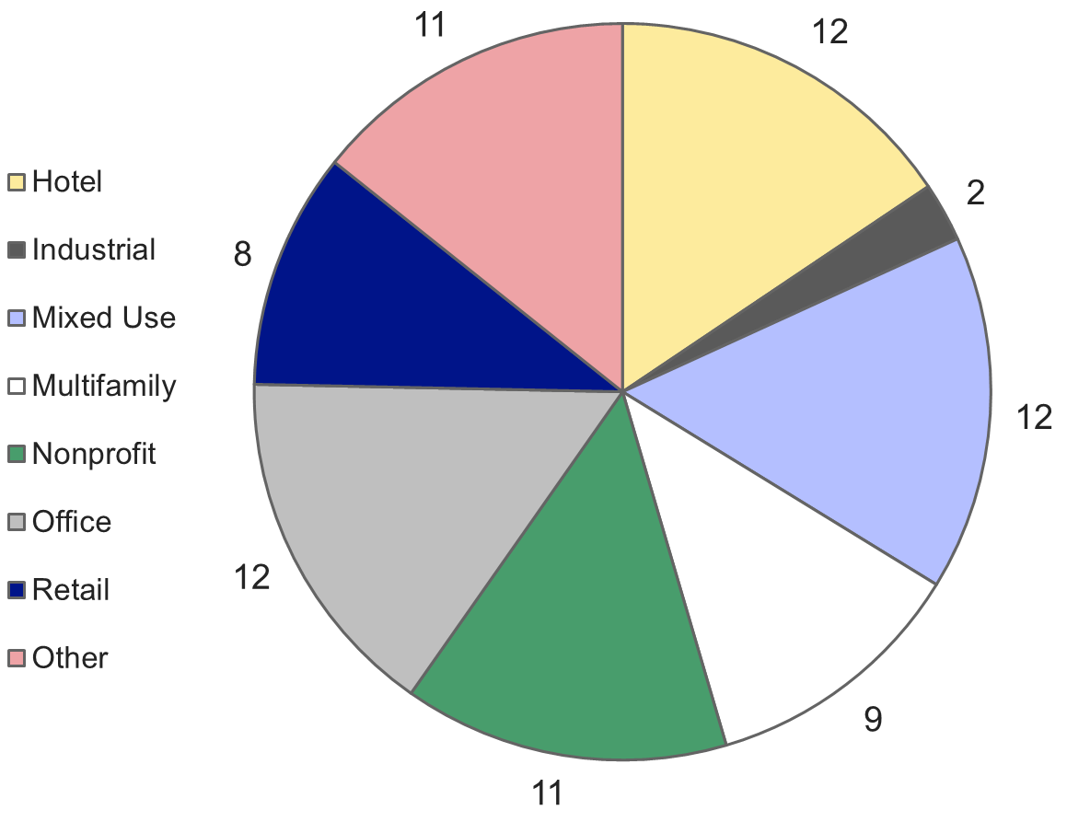
Completed PACE Projects in
Texas
Alamo Area Council of Governments

Slide 17

Financing Mechanism
The process
The detail
  Government puts first lien on the property
  Mortgage lender must provide consent
  Third-party engineer completes assessment to validate savings
Loan payments paid directly to capital provider
In case of default or bankruptcy:
  Only delinquent payments get priority over the mortgage
  Uses existing debt collection services
  PACE never accelerates
The loan stays with the property – transfers to new owner
Alamo Area Council of Governments

Slide 18
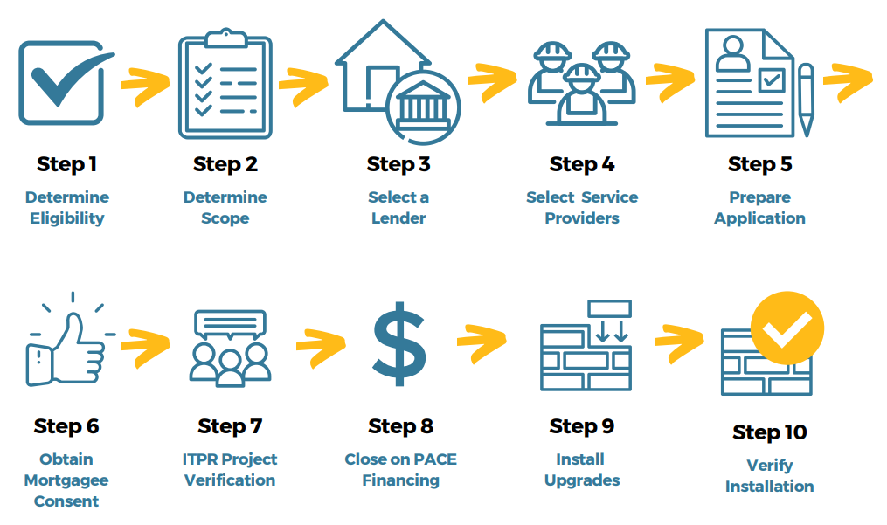
How It Works
Alamo Area Council of Governments

Slide 19
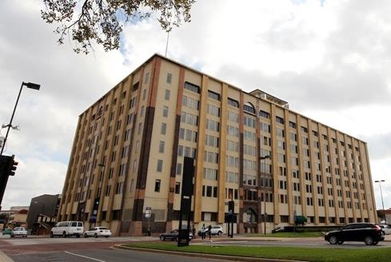
Residential Mixed Use Case Study
Butler Brothers Building | Dallas, TX
HVAC • Lighting • Insulation • Roofing • Glazing •
Plumbing • Irrigation • Building envelope
Assessment: $24,000,000
Annual Energy Savings: 40%
Alamo Area Council of Governments

Slide 20
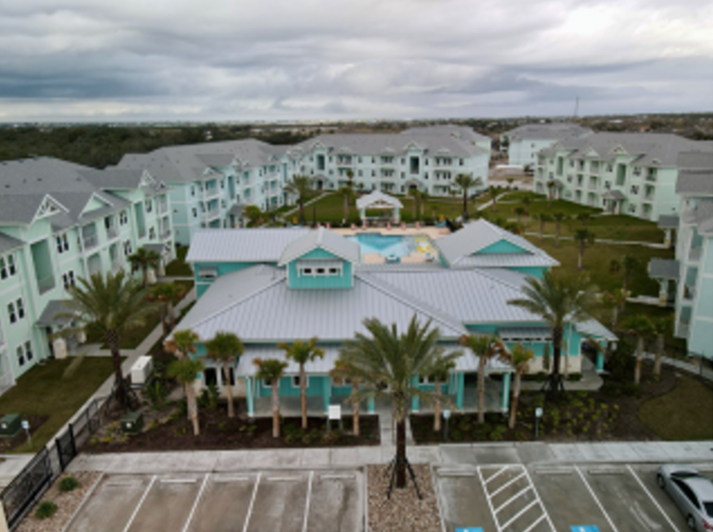
New Construction Case Study
Pearl Point Apartments Phase I
Rockport, Aransas County
Measures installed:
Above Code: Lighting • Plumbing •
Building envelope
Assessment total:
$2.75 million in 2020
$1.25 million in 2021
Annual benefits:
Electric: 925,680 kWh
Water: 3.2 million gallons
Avoided CO₂: 482 tonnes
Alamo Area Council of Governments

Slide 21
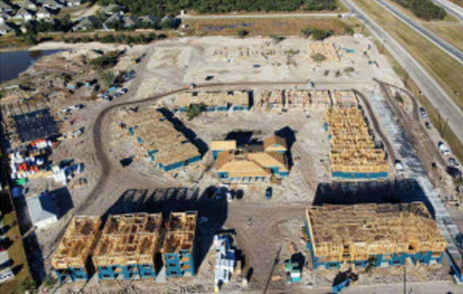
New Construction Case Study
Pearl Point Apartments Phase II
Rockport, Aransas County
Measures installed:
Above Code: Lighting • Plumbing •
Building Envelope
Assessment total:
$7.66 million
Annual benefits:
Electric: 1,140,121 kWh
Water: 4.02 million gallons
Avoided CO₂: 593 tonnes
Alamo Area Council of Governments

Slide 22

Free Energy Assessments
Texas A&M University Programs
Industrial Assessment Center - free assessments for mid-sized industries to help them stay competitive through reduction of costs; assessment will focus on reducing utility costs, increasing energy efficiency, enhancing productivity, and minimizing waste
Building Performance Assessment Center – free assessments for small and medium commercial buildings less than 100,000 square feet; evaluates building energy, waste, and productivity opportunities – including monetary savings and implementation costs
Alamo Area Council of Governments
Notes:
Building Performance Assessment Center: https://bpac.engr.tamu.edu/assessment-details/

Slide 23


Resources
Service Provider Directory
Case Studies
TX-PACE Program Guide
Application assistance/guidance
Program outreach
Keeping PACE in Texas
Alamo Area Council of Governments

Slide 24

Thank You For Your Time!
Contact Me
Email: lhufstetler@aacog.com
Phone: 210-376-9901
2700 NE Loop 410
Suite 101
San Antonio, Texas 78217

Slide 25
A Financing Alternative
UTILITY SAVINGS
UTILITY SAVINGS
REPAYMENT
INSTANT NOI
DELAYED NOI
REPAYMENT
Short financing term + Long ROI = Cash flow strain
Alamo Area Council of Governments

Slide 26

Why TX-PACE?
Property Owners
Long-term financing (up to 20+ years)
  Competitive interest rates
Up to 100% of improvements financed (100% loan to value)
Non-recourse (stays with the property)
No financial covenants
Does not tie up borrowing capacity

Slide 27
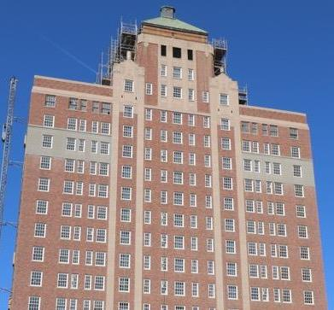
Hospitality Case Study
Plaza Hotel
El Paso County
Measures installed:
HVAC • Elevator • Lighting •
Windows • Plumbing
Assessment total:
$9.2 million
Annual benefits:
Electric: 1,488,687 kWh
Water: 770,100 gallons
Alamo Area Council of Governments

Slide 28
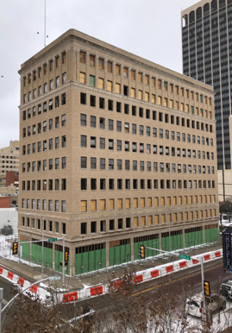
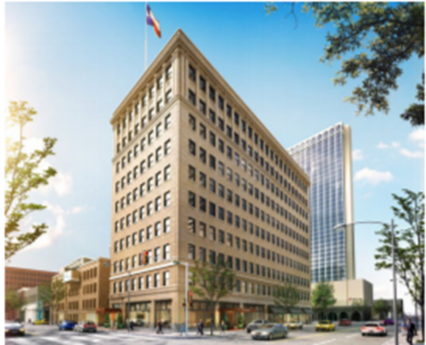
Hospitality Case Study
State Historic Tax Credit:
$9.05 million
Barfield Building
Amarillo, TX
Measures installed:
LED Lighting • Building envelope • Water efficiency • Water heating
Assessment total:
$7.36 million
Annual savings:
Electric: 73%
Natural gas: 79%
Water: 40%
Alamo Area Council of Governments

Slide 29

Why TX-PACE?
Capital Providers
Lower risk
    First lien
    Not extinguished with bankruptcy
    Guaranteed savings-to-investment ratio of ≥ 1
    Increased asset value
Faster/easier due diligence process
    Third party assessment guarantees utility savings

Slide 30
Why TX-PACE?
Mortgage Holder
Increased value of underlying asset
  Increases interest-coverage ratio
    Since SIR must be ≥ 1
NEVER accelerates
    Only the current and past-due payments are senior to the mortgage

Slide 31
Not a Loan! Here’s Why
• | Provides 100% up-front funding of all hard and soft costs
• | 20+ year repayment term = immediate income source
• | Does not tie up borrowing capacity for company
• | Requires utility savings to be validated by third party review
• | Allows property owner to select lender, contractor, and project
Alamo Area Council of Governments

Slide 32
Why TX-PACE?
• | Energy savings benefits often realized over 10-20+ years, but financing terms rarely exceed 5 years and difficult to collateralize
• | Cosmetic improvements that attract more attention get priority
• | Building stock in need of upgrades puts strain on electrical grid
• | Excess energy use contributes to regional poor air quality; adaptive reuse is more sustainable
Alamo Area Council of Governments

