Slide 1


Weatherization Roundtable
August 22, 2024
Alamo Area Council of Governments

Slide 2

AACOG Weatherization Assistance Program Overview
Alicia Avila-Penalver, Weatherization Program Manager

Slide 3
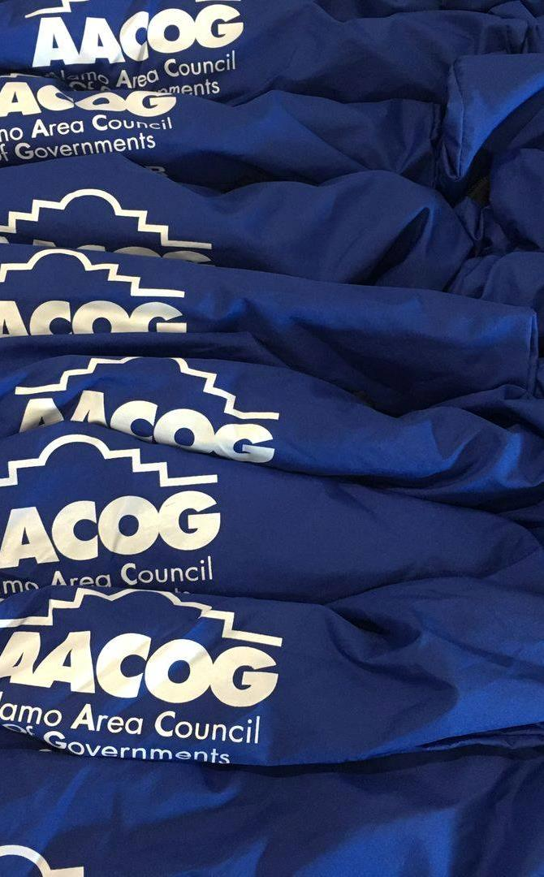
Overview
AACOG Overview
The mission of the Alamo Area Council of Governments is to enhance the quality of life of all residents of the Alamo Region in partnership with elected and appointed officials, funders, community partners and beneficiaries
Weatherization Assistance Program
This program is designed to help low-income people overcome the high cost of energy through the installation of energy conservation measures at no cost to the applicant.

Slide 4

AACOG’s PROGRAMS
Agency Administration & Management
Air Quality & Natural Resources
Alamo and Bexar Area Agencies on Aging “AAA’s”
Alamo Regional Transit “ART”
Compatible Use Program “CUP”
Intellectual and Developmental Disabilities Program “IDD”
Public Safety
Regional Services (Economic Development)
Resource Recovery
Weatherization Assistance Program
Veterans Program

Slide 5
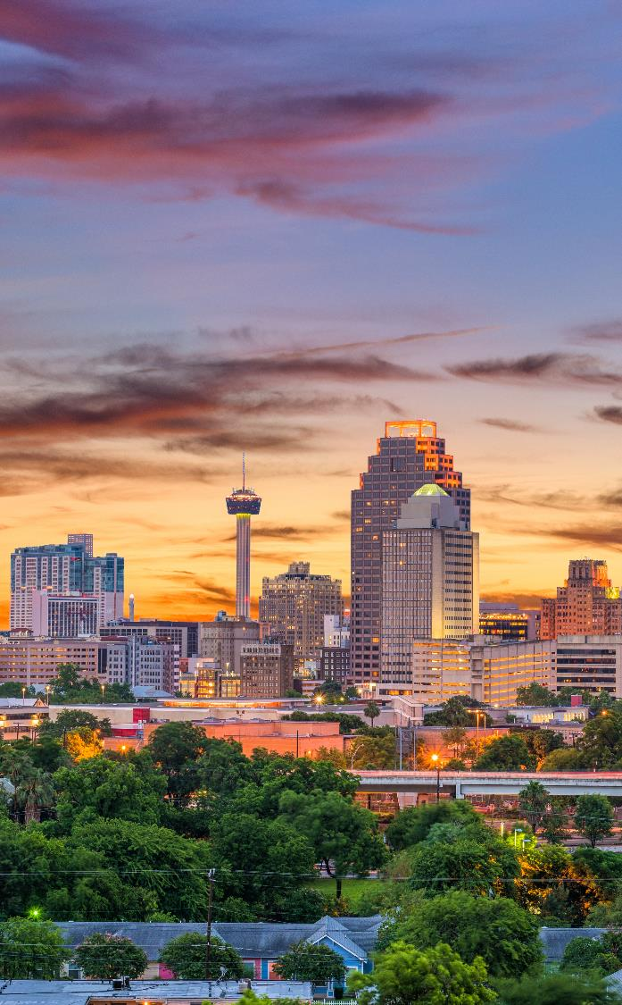
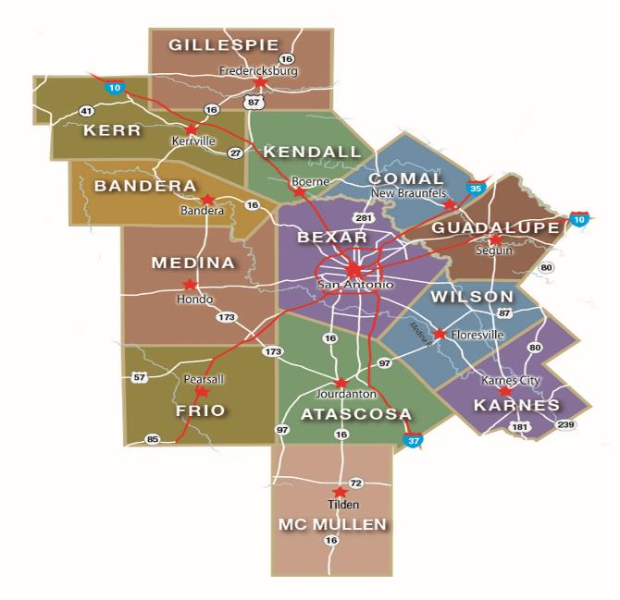
Who We Serve
AACOG serves 13 counties and 12,582 square miles. Comprising the area planning region are Atascosa, Bandera, Bexar, Comal, Frio, Gillespie, Guadalupe, Karnes, Kendall, Kerr, Medina, McMullen, and Wilson counties.
*McMullen County receives its weatherization services from the Community Action Committee of Victoria

Slide 6
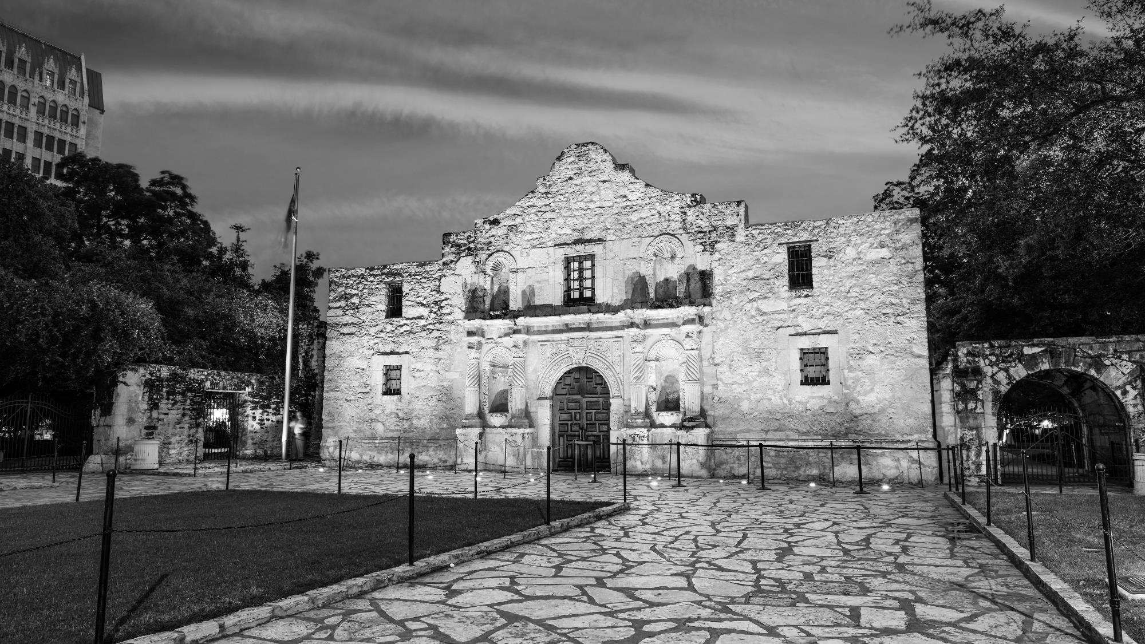
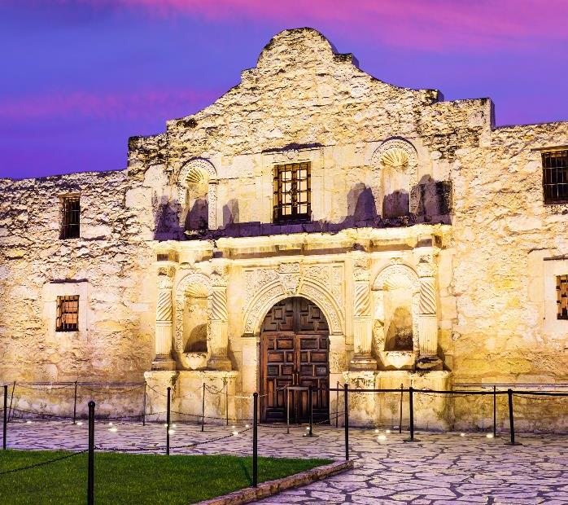
Funding Sources
Department of Energy (DOE)
July 1, 2024 – June 30, 2025
$721,198
Project Units – 50
Cost Per Unit - $8,250
Low Income Home Energy Assistance Program (LIHEAP)
January 1, 2024 – December 31, 2024
$919,614
Projected Units – 57
Cost Per Unit - $12,000
Department of Energy Bipartisan Infrastructure Law (DOE BIL)
July 15, 2023 – June 30, 2026 (3-year grant)
$3,511,208
Project Units – 250
Cost Per Unit - $8,250

Slide 7
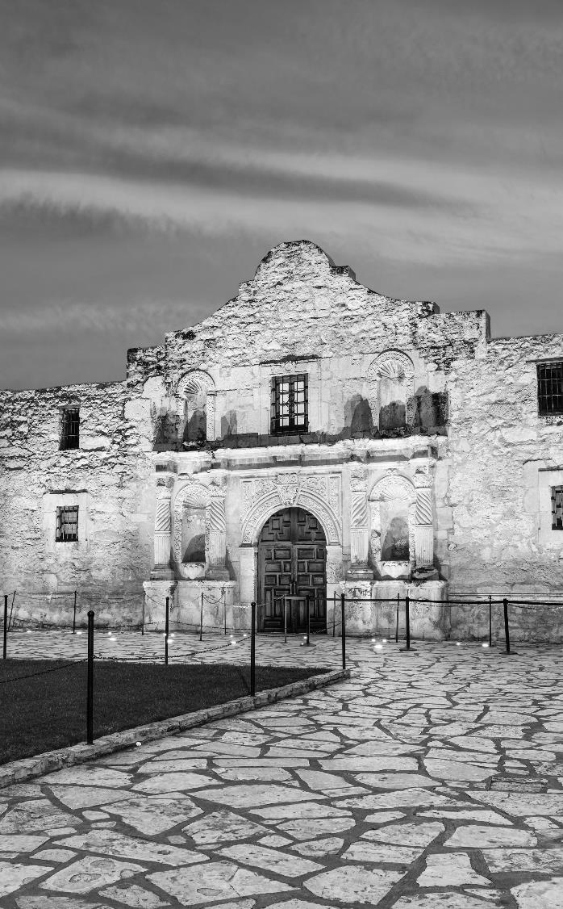
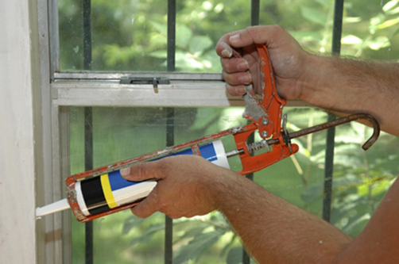
What services does weatherization provide?
Insulating attics and walls.
Weather stripping of doors and windows.
Caulking and sealing cracks and holes in the house’s structure.
Incidental repairs to preserve and protect the weatherization materials installed.
Refrigerators, HVAC, stoves and water heaters will be tested and may be tuned up or replaced if approved by funding agency.
NOTE: The Weatherization Program does not do home repairs such as: roofing, plumbing, electrical or house leveling.

Slide 8

Does the person have to be over 60 to qualify?
Does the person have to own their home to qualify?
NO! Renters, as well as homeowners, are eligible to apply as long as your landlord gives written permission for the work to be done.
NO! All age groups are eligible to apply as long as you’ve lived in your home for 12 months.

Slide 9

What does the client have to pay?
NOTHING!
It is FREE to people who are income eligible and accepted into the program. However, not all people who are eligible will be served immediately. Priority is given to the elderly, disabled, homes with children under 6 years old and those with a high energy burden.
Weatherization services are available once every fifteen years.

Slide 10

Am I eligible for assistance?
If your income falls at or below the federally established income guidelines, then you may qualify.
Family Size | LIHEAP 150% | DOE 200%
1 | $22,590 | $30,120
2 | $30,660 | $40,880
3 | $38,730 | $51,640
4 | $46,800 | $62,400
5 | $54,870 | $73,160
Amount to add for each additional family member | $8,070 | $10,760

Slide 11
What is the weatherization process?
Assessment
Once you are approved, we will contact you to schedule an inspection of your home.
Weatherization
A household member age 18+ must be at the home in order for the contractor to complete the weatherization work.
Final Inspection
AACOG and/or the city inspectors will be conducting a final inspection of your home.
Application
The applicant will be contacted if they need to provide any additional documents.

Slide 12
ESTIMATED ENERGY SAVED
According to the DOE, the average annual energy saved is 29.3 MBTUs (million British thermal unit) per dwelling unit weatherized. TDHCA used the applicable conversion rate of 293.1 to convert the MBTUs to kilowatt-hours. For an estimate of energy saved, TDHCA used the following formula:
[Total Units] x 29.3 x 293.1
To calculate money saved, TDHCA multiplied the total kilowatt-hours saved by the DOE average retail residential electric rate per kilowatt-hour, which is $0.1278 per kWh for Texas in 2021.4 TDHCA used the following formula:
[Energy Saved] x [average electric rate price (per kWh)].
AACOG | TOTAL UNITS | ENERGY SAVED (kWhs) | MONEY SAVED ($)
2022 | 156 | 1,339,701.48 | $171,213.05
2023 | 116 | 996,188.28 | $127,312.86

Slide 13
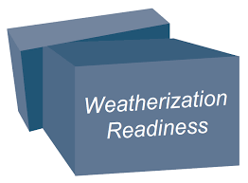
WEATHERIZATION READINESS FUNDS
This funding is specifically targeted to reduce the frequency of deferred homes that require services outside the scope of weatherization before the weatherization services can commence. Units receiving WRF must result in in a DOE completion defined as “A dwelling on which a DOE-approved energy audit or priority list has been applied and weatherization work has been completed
July 1, 2024 – June 30, 2025
$71,125
Max allowable funding per home - $8,000
Estimated # of homes to be assisted - 8

Slide 14



NEED TO MAKE A REFERRAL FOR A SENIOR?
The Gateway to Services and Support in your Community
ADRC in Texas
1-855-937-2372
Alamo Service Connection
www.askasc.org
210-477-3275

Slide 15
NEED TO MAKE A REFERRAL FOR A VETERAN?
Alamo Veterans Network
Phone: 1-888-SA 4 VETS
(888-724-8387)
Online: https://aacog.com/index.php/veteran-services

Slide 16

Thank You For Your Time
Contact Us
Main Phone: 210-362-5282
Direct Line: 210-832-5085
Fax: 1-866-387-2280
8200 Perrin Beitel
Suite 101
San Antonio, Texas 78218

Slide 17
01 Discussion
Are Texas homes built to withstand the states future weather events?

Slide 18
02 Discussion
How often do you see/hear of residents turned away from weatherization assistance?
What are they commonly denied for?

Slide 19
03 Discussion
How should weatherization programs determine eligibility?
Are restrictions too restrictive? What restrictions could be done away with?

Slide 20
04 Discussion
What additional improvements should be considered for inclusion in weatherization funding?

Slide 21
05 Discussion
How aware are you of the availability of weatherization assistance programs?
How about your communities?

Slide 22
06 Discussion
How can we improve education about weatherization programs?

Slide 23
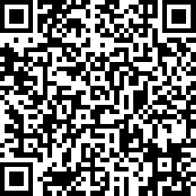
Thank You For Your Time
Take Our Survey!
Contact Us
Mariah Sanchez
Natural Resources Outreach Specialist
msanchez@aacog.com
210-461-8770
Lyle Hufstetler
Natural Resources Program Administrator
lhufstetler@aacog.com
210-376-9901

