Slide 1
Alamo Area Clean Cities Stakeholder Meeting
February 18, 2025

Slide 2
Today’s Agenda:
Brief Overview of AACCC
Upcoming Events
Funding Opportunities
Networking Lunch

Slide 3
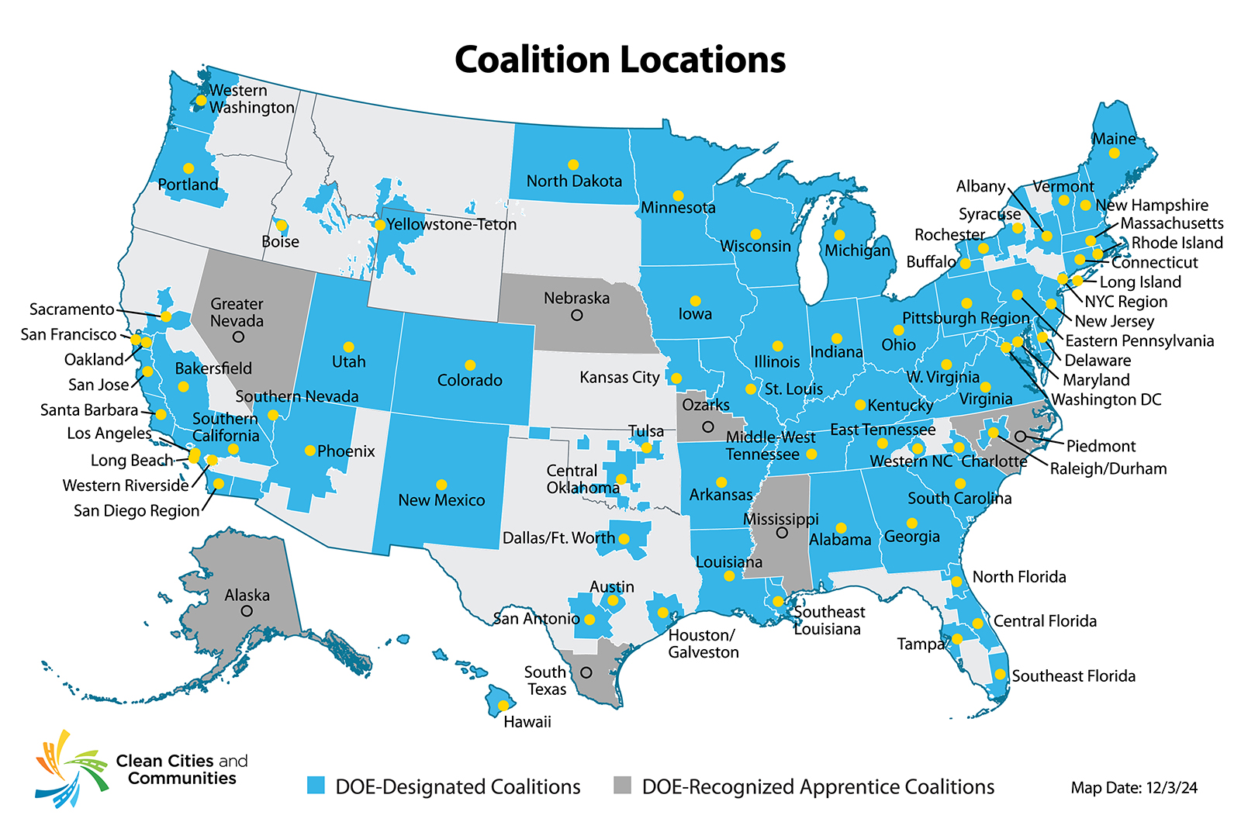
Clean Cities and Communities Coalitions Advancing affordable, domestic transportation fuels and technologies
Forums for local stakeholders to connect and collaborate
Provide grassroots support and resources
Identify cost-effective solutions that work locally

Slide 4
Technology Integration
Provide objective data and real-world lessons learned that inform future research needs and support local decision-making
Information and Tools
Technical Assistance
Financial Assistance
Training, Outreach, & Partnerships

Slide 5
Group Introductions
Name, organization, role
Familiarity with Clean Cities
Familiarity/experience with alternative fuel projects

Slide 6
Upcoming Events & Priorities

Slide 7
Clean Cities Coffee Chats
First Thursday of the month at 9:00am
Informal, conversational monthly calls with regional organizations to facilitate collaboration
Want to discuss grant partnerships? Regional goals? Organization-specific goals? Come to our coffee chats and we can connect you to the resources you need!

Slide 8
Air Quality Committee Meeting
February 26, immediately following the Board Meeting (~11:30)
Discussing recent coalition initiatives
Will serve as the official governing body of coalition activities

Slide 9
2025 Priorities
Facilitating Regional Success
Creating connections on clean transportation grants and projects
Increasing engagement with relevant community organization
First Responder Training
Part of multi-Coalition effort to bring EV first responder training to our respective regions
EV and battery storage workshop
Notes:
Talk about TDLR webinar – tentatively scheduled for May 29

Slide 10
Discussion
What’s an upcoming event or initiative your organization is working on?
What can AACCC do to help support?

Slide 11
Guest Presentation & Funding Discussion

Slide 12
Regional Services
Serves its member governments and residents in efforts of creating strong viable communities, strong economies, and informed and trained public officials
Provides technical assistance and advocacy in several program areas
Provides technical assistance, research, and data to both the public and private sector in the development of projects and plans, which create jobs and build a stronger economy
01

Slide 13
Regional Services
AACOG is an Economic Development District (EDD) designated by Economic Development Administration (EDA).
Serves Planning District 18
Develops and implements a comprehensive economic development strategy (CEDS) every 5 years
AACOG hosts 3 to 5 workshops annually.
Planning & Zoning
Elected Officials
Economic Development
Brownfields
Legislative Update
01

Slide 14
Regional Services
AACOG supports government members, as well as their community and area partners, in pursuing funding for projects.
Infrastructure
Job Training
Construction
AACOG provides government members access to grant funding opportunities via GrantFinder.
AACOG provides grant writing, and grant administration and fiscal services.
01

Slide 15
Grant Funding Opportunities
Federal Grants:
EDA Public Works and Economic Adjustment Assistance
USDA
Rural Business Development
US Forestry Service
EPA
US Department of Transportation
HUD
Health and Human Services
Department of Labor
01

Slide 16
Grant Funding Opportunities
State Grants:
Texas Department of Agriculture
TxCDBG 2025-2026
Broadband Development Office (BDO)
Broadband Equity, Access and Deployment (BEAD) Program
01

Slide 17
Grant Writing Administration and Fiscal Services
01
SCOPE:
Provide grant and fiscal administration services:
Reporting
Compliance
Fiscal management

Slide 18
Grant Writing Administration and Fiscal Services
01
HOURLY RATES
$100 to $150 per hour
Average prep time is 15 to 20 hours for state and foundation grants
Average prep time is 50 to 60 hours for federal grant applications
NEGOTIABLE

Slide 19
Grant Writing Administration and Fiscal Services
01
Administration
15% of grant amount (project amount + 15%)
Includes grant writing
Grant compliance and reporting

Slide 20
For More Information:
01
Claudia Mora
Regional Services Administrator
210-918-1284
cmora@aacog.gov

Slide 21
Discussion
What funding opportunities are you looking to secure/ have recently secured?
How can we help your organization meet your funding goals?

Slide 22
Thank you!
Contact Us:
Lyle Hufstetler LHufstetler@aacog.com
Ella Nash
enash@aacog.com

