Slide 1
Strategies for Supporting Solar Adoption in Your Community and on Your Own Properties June 5, 2025

Slide 2
Session 4 agenda
Welcome
Cohort Progress and Session Overview
Community-Facing Opportunities to Support Solar
Municipal Procurement Best Practices
Next Steps
Discussion + Q&A

Slide 3
Who you’ll hear from
Lyle Hufstetler
Project Administrator
AACOG
Mariah Sanchez
Natural Resources Outreach Specialist
AACOG
Andrew Light
Clean Energy Associate
WRI
Lilyana Gabrielse
Clean Energy Analyst
WRI

Slide 4
Cohort Progress and Session Overview

Slide 5
Cohort structure & timeline
1-on-1 check-ins
February 27, 2025
Session #1: Setting the stage for solar development
Session 2: Planning for solar
Best practice guidance for planning and zoning of small and large-scale solar arrays
Session 3: Permitting & inspection for solar
Session 4: Community engagement & municipal operations
Guidance on how to support residents, businesses, and your own operations teams as they consider adopting solar
June 5, 2025
March 27, 2025
July 9, 2025
Session 5: Wrap up & next steps
Address any outstanding questions and chart a pathway forward
April 24, 2025
Overview of regional and state energy context
Training on best practices for permitting and inspecting solar arrays
Access to 1-on-1 technical assistance support

Slide 6
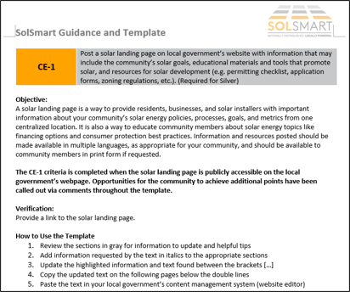
Session 4 overview
This session will focus on elements across multiple SolSmart categories, including “Government Operations”, “Community Engagement”, and “Market Development”.
Attendees do not earn specific criteria solely by attending today’s session, but the session will cover multiple pre-requisite criteria (for Silver and Platinum designation tiers) and other relevant criteria that can support both designation and your broader solar efforts.
As a reminder, your community will need to earn 20 points from criteria in any of the aforementioned categories to achieve Bronze designation.
Solar Landing Page Template
A solar landing page can earn your community between 10 – 50 points

Slide 7
Local governments have several levers to pull to affect the local solar market
Local plans (e.g., comprehensive plans, climate action plans, etc.)
Codes and ordinances (e.g., zoning code, building code, tax code, etc.)
Permitting processes and requirements
Community engagement efforts
Municipality-led (or supported) program and projects
Municipal procurements
Notes:
Being explicit about how a fundamental change is necessary to achieve goals

Slide 8
Community-Facing Opportunities to Support Solar

Slide 9
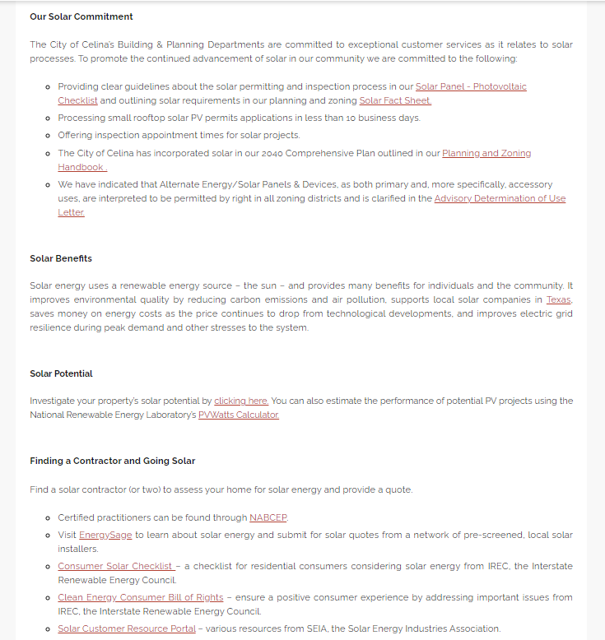
Creating a “solar landing page” consolidates all important solar-related information into a centralized location
Celina, TX Solar Landing Page

Slide 10
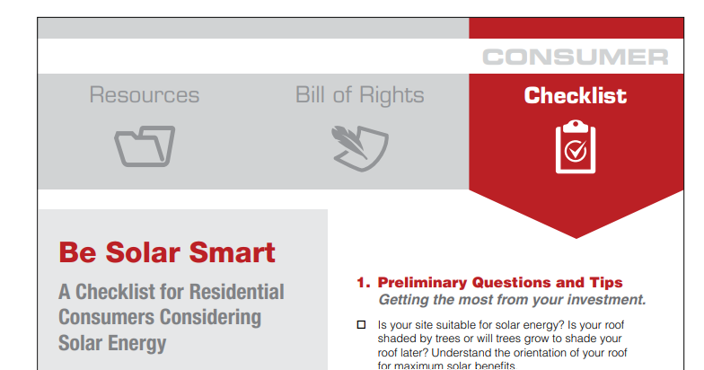
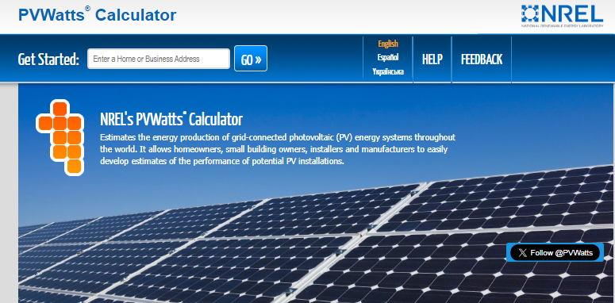
Residents and community-based organizations may turn to the local government for information on solar energy
Consumer Bill of Rights
Local governments can consider including the following information on a solar landing page:
Permitting, inspection, and zoning requirements
Community-wide goals (and relevant progress)
Map of installations and/or solar potential
Local, state, and federal incentives for solar (and storage) deployment
Consumer protection considerations
Local contractors and solar-related job training opportunities
Information on ownership and financing options
Other key links to programs, projects, and resources
Solar Potential Calculation Tool

Slide 11
Residents and businesses have a chance to benefit from federal incentives and programs
Significant tailwinds are supporting solar energy development and making it more affordable than ever to go solar. For example, the Inflation Reduction Act (IRA) and Bipartisan Infrastructure Law (BIL) provide:
Tax credits for residents and businesses that install solar (and other clean energy resources) and make upgrades to their homes/businesses.
Grants and programs that support specific applications of solar, such as brownfield development and community solar.
Funding to support uptake by low- and moderate-income residents, such as through the EPA’s Greenhouse Gas Reduction Fund (GGRF).
One component of the GGRF is the "Solar for All" program, which will deploy $7 billion to enable over 900,000 households in low-income and disadvantaged communities to benefit from distributed solar energy. A coalition of local governments in Texas will receive $249,700,000 and there are other non-profits working across multiple states (including Texas) to deploy even more projects.

Slide 12
A bulk purchase campaign can both educate consumers and support solar deployment
Local government can support bulk purchase campaigns by amplifying communications around them, helping to launch them, or developing strong partnerships with community-based organizations that run them.
The benefits of bulk purchase campaigns can be enhanced and made accessible to a more diverse array of residents by:
Deploying credit enhancements, such as interest rate buy downs, loan loss reserves, or revolving loan funds.
Offering loan options targeted at low-income residents or residents with poor or no credit.
Leveraging local, state, and/or federal funding streams to cover certain costs.

Slide 13
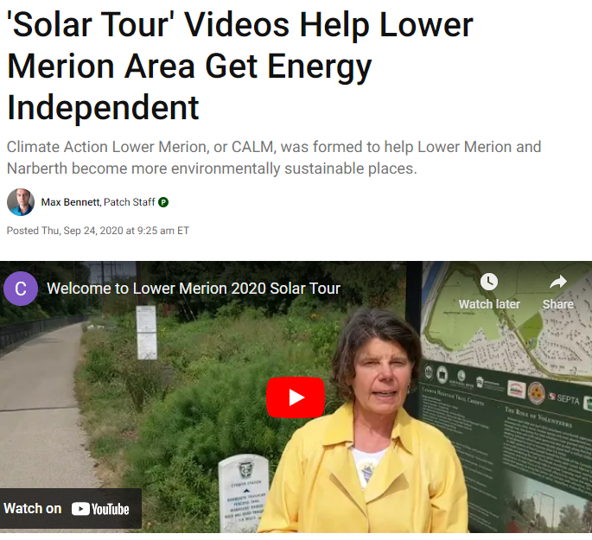
Developing and participating in community-centric events around solar can ensure residents have access to staff support
Solar Tours Video
Being able to see solar and talk to people who have adopted it is critical. Localities can sponsor solar tours to help people see solar in action in their community.
(CE-13) Support a solar informational session and/or solar tour explaining solar PV opportunities and policies.
Local governments can also attend and table at various events, from street fairs and festivals to other types of gatherings, and present on solar-related opportunities in the community.
In addition to participating in external events, local governments can start task forces and other committees to further explore opportunities to advance solar locally.
(CE-12) Discuss solar PV goals and/or strategies for increasing solar PV development, including large-scale solar plans, solar access, and/or solar adoption in disadvantaged communities, within an appropriate committee, commission, taskforce, and/or working group.

Slide 14
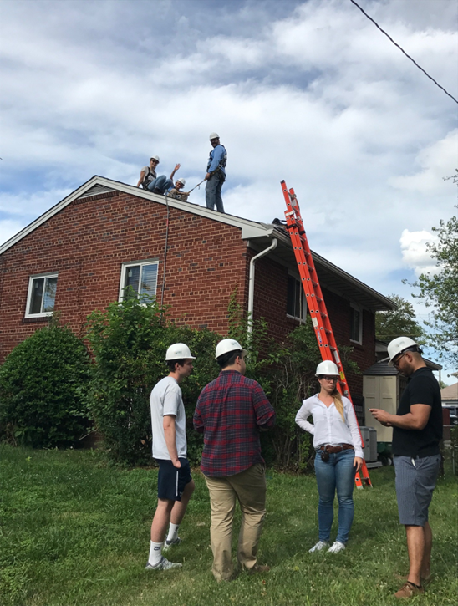
Engaging with schools can support solar education and workforce development
While school districts may be independent from local governments, they remain an important constituent on solar-related issues:
Consider approaching school districts on incorporating solar and other energy-related issues within curriculums
Technical high schools may be able to develop a workforce development program around solar to provide education and job placement for more solar workers
School buildings can be excellent candidates for on-site solar, but staff may not have the relevant expertise. Consider sharing any lessons learned and best practices to support their efforts.

Slide 15
Municipal Procurement Best Practices

Slide 16
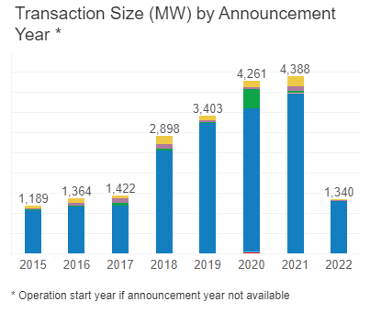
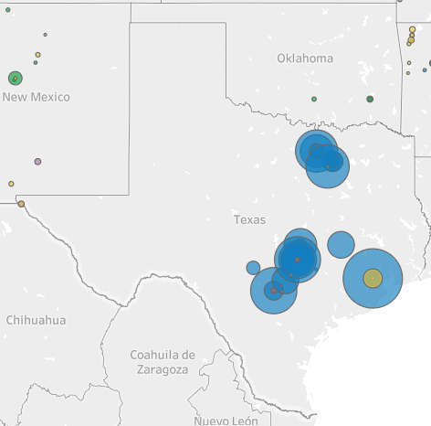
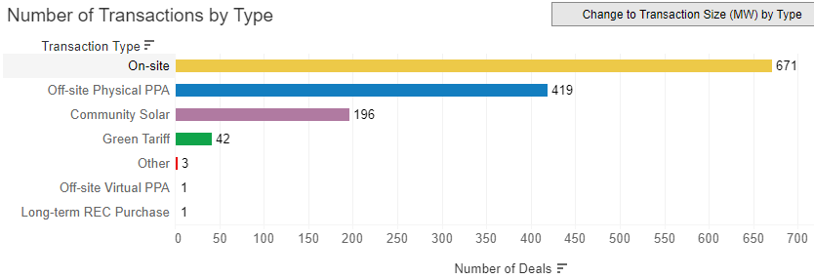
Local governments can lead by example and procure solar energy for their facilities
Local governments nationwide have participated in transactions for over 20,200 MW of solar since 2015 (~966 MW on-site solar)

Slide 17
Local governments have several options when considering solar for municipal operations
Unbundled Renewable Energy Certificates
Renewable Energy Produced On-site
Renewable Energy Purchased from Off-site Sources
AND/
OR
AND/
OR
Renewables Developer/Generator
Traditional
Utility
Off-site power purchase agreement (PPA)
Green pricing programs
Green tariffs
One-off utility deals
Community solar

Slide 18
Local governments have several options when considering solar for municipal operations
Environmental
Impact
Local
Economic Impact
Financial Impact
Scalability &
Contribution to Goals
Reduce enterprise, municipal and/or community-wide GHG emissions
Decrease vulnerability to climate change impacts
Improve air quality and public health
Support local workforce development and job creation
For public entities, increased tax revenue
For private enterprises, advancing beneficial CSR/ESG impact
Reduce organizational energy expenditures
Hedge against future energy price increases
Identify opportunities for economies of scale
Demonstrating commitment to organizational and/or community goals

Slide 19
Local governments have several options when considering solar for municipal operations
Equity
Grid Resilience
Clean Energy
Leadership
Ease of
Procurement
Expand RE access to low- and moderate-income or other disadvantaged communities
RE impacts on improving environmental justice
Utilize underdeveloped sites
Increase local energy resilience
Renewable energy systems and storage are one solution(s) in mitigating risk exposure from energy system disruption (infrastructure failure from natural disasters and other system shocks)
Generate positive press for your organization (public and private entities) and city and/or city leadership
Develop innovative or novel solutions (wow factor!)
Go beyond business as usual
Increase renewable energy access for all
Reduce risk and complexity of the transaction
Align development and contract length with local goals (e.g., quick win vs. long-term strategy)
Provide flexibility

Slide 20
Local governments can lead by example and procure solar energy for their facilities
Build Your Team
Energy Manager(s)
Evaluate On-Site Solar Opportunities
Compile an inventory of buildings, parking lots, and land near municipal facilities
Use tools like Project Sunroof and PVWatts to evaluate solar potential
Understand what ownership, funding and financing options are available
Develop your RFP and evaluate proposals
Financial Departments
Procurement Officers
Facility/Site Manager(s)
Decide on Ownership and Financing
Negotiate terms and award your contract
Monitor Results and Learn
Record lessons learned from the procurement process
Run Your Solicitation

Slide 21
Develop a procurement team that will support an efficient and durable outcome
Identify the group of staff that will help you lead this clean energy procurement.
Your internal team should include the necessary staff who understand your local facilities, can help you acquire funding for your project, have the legal expertise to review contracts, and know the procurement process.
Notify team members and critical stakeholders well in advance of important deadlines to avoid significant delays and setbacks.
Facilities manager
Finance Director or Staffer
City/County Legal Counsel or Team Member
Energy or Sustainability Manager/ Team Lead
Staffer of Mayor or City Manager
Procurement Team Lead or Staffer

Slide 22
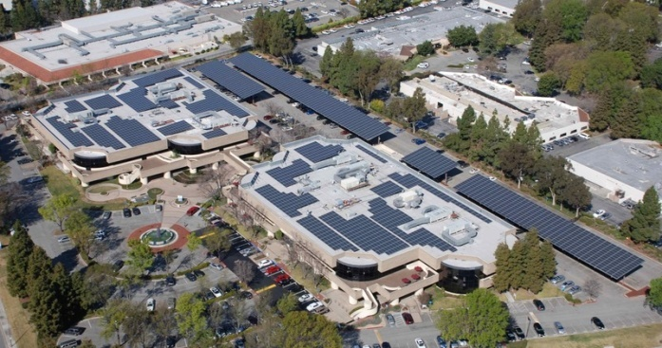
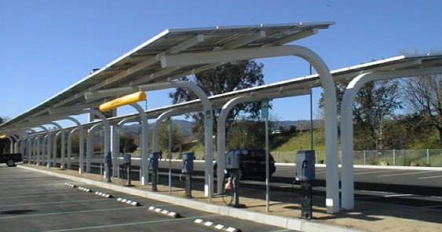
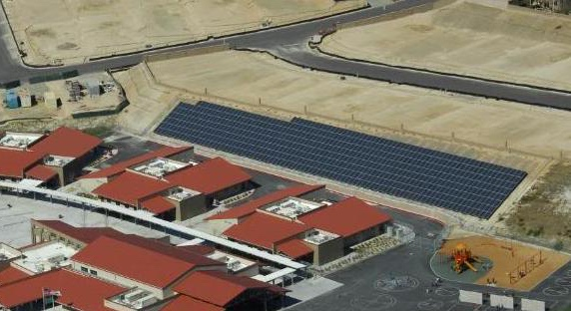
Local governments have multiple siting options available to deploy distributed solar
Rooftops
Screen to identify roofs with highest potential
Determine accurate avoided costs and net metering rules
Aggregate buildings to realize scale
Parking Lots/Garages
Typically cover ~20% of a city’s surface
Higher upfront costs relative to rooftop PV but offer co-benefits (e.g. shade, rain protection, EV-ready, land-use)
Ground-Mounted
Large PV arrays on municipally-owned property such as
Landfills
Brownfields
Water treatment
Identify local virtual net metering rules

Slide 23
Selecting your site will take careful analysis of techno-economic potential
Site Characteristics
Economic impact
Utility rates
Comparison of systems pricing
Local workforce and economic development
Structural and electrical evaluation
Building orientation
Shading from trees, buildings, power lines
Roof type, age, weight bearing ability
HVAC or other rooftop obstacles
Location of interconnection points
Damage or theft hazards
Construction concerns and design considerations
Site use planning and parcel ownership
Additional uses/benefits for solar carports
Funding and incentives
Levelized Cost of Energy (LCOE) analysis to determine savings
Net Energy Metering (NEM)
RMI’s Municipal Solar Site Selection Tool (MSSST) is an effective tool for identifying and screening possible sites and provides information on steps necessary to conduct preliminary site evaluations.
EPA - Solar Site Assessment and Utility Data Spreadsheet
View
This template is designed to help users collect information about potential solar project sites.

Slide 24
Multiple ownership models also exist to support local government procurements
Ownership
Third Party Ownership
Energy Performance Contract
The city purchases the installed PV system, typically through a loan
A third-party purchases and installs the PV system and the city pays the third party for either through a power purchase agreement or a solar lease.
An ESCO purchases and installs the PV system along with other energy efficiency measures and the buyer pays the ESCO a percentage of verified energy cost savings.
Pros
Typically more lifetime savings
Buyer may access low-cost debt
Buyer inherently owns RECs
Buyer may be able to take advantage of tax incentives
No upfront cost to the buyer
Buyer has less operational risk
Buyer can take advantage of tax incentives
No upfront cost to the buyer
Guaranteed energy savings
Low risk
Can be combined with energy efficiency projects
Cons
Buyer must pay/finance upfront costs
More operational risk
Buyer may not be able to utilize tax incentives
May need approval for municipal debt
May have lower long-term economic returns
May have more restrictive clauses
Buyer likely pays a premium for RECs
May have lower long-term economic returns
Requires a robust measurement and verification process
Buyer likely pays a premium for RECs

Slide 25
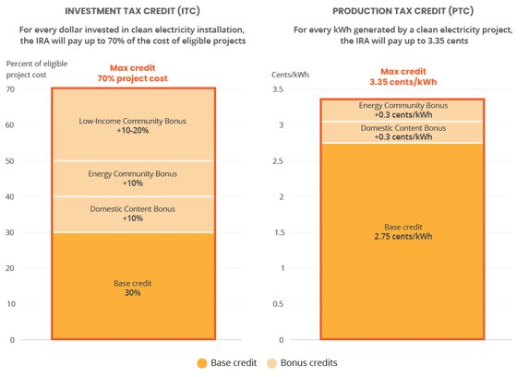
Federal tax credits can reduce the cost of systems and local governments can now take advantage of these credits
The Investment Tax Credit (ITC) and Production Tax Credit (PTC) are longstanding tax credits that incentivize clean energy development and the IRA made significant changes by extending the lifetime of these credits and expanding the scope of what they cover.
Elective pay is a means of delivering 12 climate and clean energy tax credits to eligible tax-exempt entities as direct payments.
Eligibility includes most tax-exempt entities, including:
State, local, tribal, and territorial governments
Any agency or instrumentality of an eligible government (school districts, public power utilities, fire departments, libraries, etc.)
Any organization exempt from taxes under section 501, including 501(c)(3) organizations and religious institutions

Slide 26
The Investment Tax Credit (ITC) and Production Tax Credit (PTC) are the most relevant tax credits for clean energy
The ITC and PTC are longstanding tax credits that incentivize clean energy development and the IRA made significant changes by extending the lifetime of these credits and expanding the scope of what is covered by these credits.
Investment Tax Credit (ITC)
Based on a percentage of eligible cost for a project
Production Tax Credit (PTC)
Based on the amount of energy produced and sold by a system in a year
As of 2023, equal to 2.75 cents per kilowatt-hour (kWh)
As of 2023, equal to 30% of the total eligible costs of a project if certain labor requirements are met
Can be claimed every year for the first ten years of a system's life
Claimed and received once when a project is placed in service
Covers energy storage as of 2023
Does not cover energy storage
Becomes tech-neutral as of 2025
Becomes tech-neutral as of 2025

Slide 27
What is elective pay?
Elective pay is a means of delivering 12 climate and clean energy tax credits to eligible tax-exempt entities as direct payments.
Eligibility includes most tax-exempt entities, including:
State, local, tribal, and territorial governments
Any agency or instrumentality of an eligible government (school districts, public power utilities, fire departments, libraries, etc.)
Any organization exempt from taxes under section 501, including 501(c)(3) organizations and religious institutions
Elective pay is not competitive. As long as you meet the qualifications to receive the tax credit, you will receive the refund.
Elective pay refunds come after the project has already begun (and possibly completed).
You must pre-file for each direct pay project as soon as you are able, and then file a tax-exempt return with the IRS to claim.
IR-2023-116, IRS releases guidance on elective payments and transfers of certain credits under the Inflation Reduction Act (June 14, 2023)
Notes:
Investment Tax Credit (ITC) (§48) (through 2024)
Clean Electricity ITC (§48E) (beginning 2025)
Production Tax Credit (PTC) (§45) (through 2024)
Clean Electricity PTC (§45Y) (beginning 2025)
Zero-Emission Nuclear Power Production Tax Credit (§45U)
Alternative Fuel Vehicle Refueling Property Credit (§30C)
Credit for Qualified Commercial Clean Vehicles (§45W)
Clean Fuel Production Credit (§45Z)(beginning 2025)
Clean Hydrogen Production Tax Credit (§45V)*
Credit for Carbon Oxide Sequestration (§45Q)*
Advanced Manufacturing Production Credit (§45X)*
Advanced Energy Project Credit (§48C)

Slide 28
Key things to know about Elective Pay
Funds received as tax-exempt grants do not reduce the basis for any investment tax credit eligible for elective pay.
Elective pay requires a pre-filing registration process. Entities must pre-file for all projects they intend to claim through an online registration process. Timing process is based on relevant entities' fiscal year.
Elective pay entities may not sell their tax credits through transferability.
Entities will have to file a tax return even if they do not normally file taxes. More guidance on this process is forthcoming.
Using tax-exempt bonds can reduce the amount of a tax credit received by up to 15%.
Elective pay entities are subject to domestic content requirements for the ITC and PTC.
Elective pay refunds will come after the project has been financed and has started construction.
IR-2023-116, IRS releases guidance on elective payments and transfers of certain credits under the Inflation Reduction Act (June 14, 2023)
Notes:
Initial direct pay and transferability guidance released June 14. Have 60 day comment period. Proposed guidance does not address domestic content exceptions for elective pay. In the private sector, tax credits must be monetized as reductions of tax liability, leading to complicated tax equity structures. Elective pay offers a cash payment from IRS.
As a reminder, direct pay allows eligible entities to receive direct payment rather than reduction of tax liability. Helps expand list of entities that can access these. This list focuses on local government entities, but also includes Tribes, nonprofit entities, hospitals, and TVA
There's some substantial burdens/questions in here – eg the filing process (990-Ts plus others) for state and local entities not used to filing paperwork with Treasury. and the timing of payment which will happen after – ie entities shouldn't expect to see payment until after project placed in construction, will need to be able to have cover some initial costs
Initial guidance answered some of the key questions, including on interaction with grants and the pre-filing process and timing.
There's some substantial burdens/questions in here – eg the filing process (990-Ts plus others) for state and local entities not used to filing paperwork with Treasury. and the timing of payment which will happen after – ie entities shouldn't expect to see payment until after project placed in construction, will need to be able to have cover some initial costs
An example of grant and tax credit stacking: for example, if Cohoes, NY wanted to fund a solar installation worth $100,000, and they got a grant worth $60,000 for the project, the basis for calculating their tax credit is still $100,000. With the normal 30% ITC rate, that credit is worth $30,000. In total, then, Cohoes would end up getting $90,000 of the $100,000 of the property covered!

Slide 29
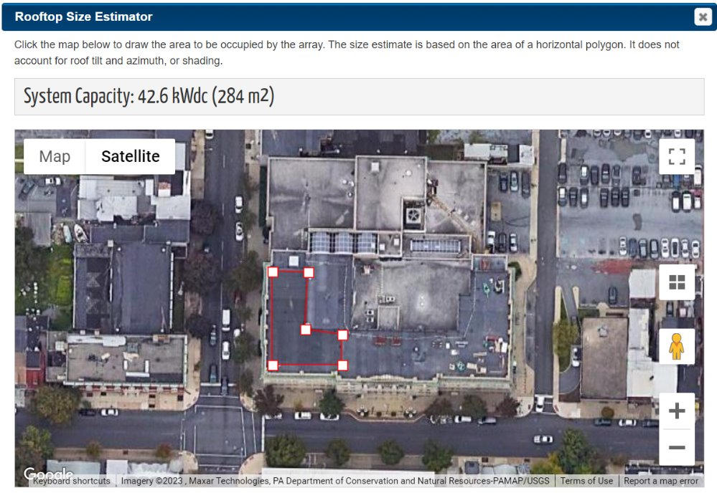
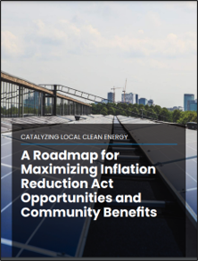
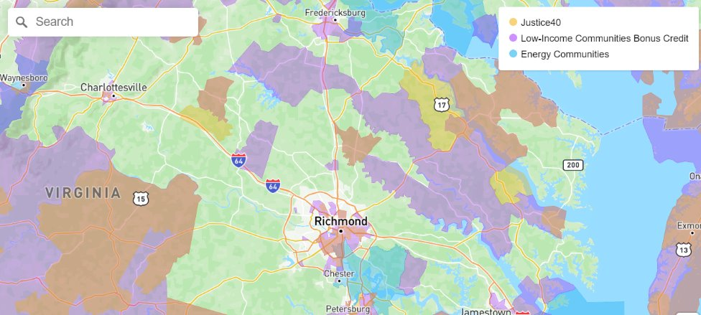
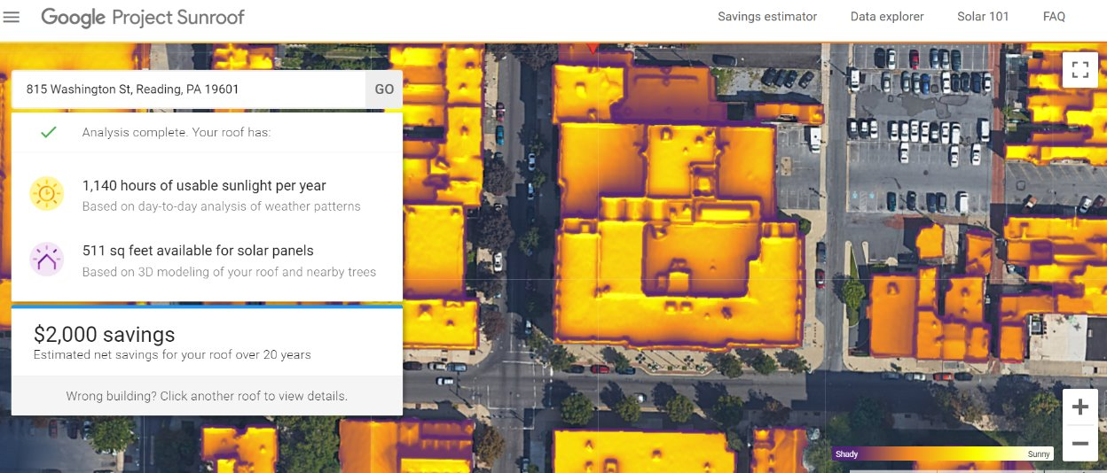
Tools and resources that can support your efforts for developing onsite solar
Federal Funding Guide
IRA/Elective Pay Guide
NREL Solar Potential Calculation Tool
Map for Tax Adder Eligibility
Google Project Sunroof

Slide 30
Discussion + Q&A

Slide 31
Discussion Questions
How are conversations going with other departments involved in the SolSmart process, such as colleagues in the planning and building departments?
Do you have any updates related to your progress to achieve SolSmart criteria (e.g., the permitting checklist) or to solar energy broadly (e.g., grants won, projects advancing, etc.)?
What questions do you have for us about municipal procurement or community engagement?

Slide 32
Next Steps

Slide 33
Supporting activities post workshop 4
Determine the feasibility of and process for developing a solar landing page.
If it's feasible to create the landing page, determine what content you want to include on it.
Research and find resources that address these content areas; the SolSmart template and the landing pages of peer local governments are the best places to start.
Launch the webpage and highlight it through relevant media channels (e.g., newsletters and social media).

Slide 34
Workshop 5 Focus Area(s)
Please share in the chat areas that you want to learn more about and/or discuss at our final workshop. Topics could include anything from across the SolSmart categories of:
Permitting and Inspection
Planning and Zoning
Government Operations
Community Engagement
Market Development

Slide 35
A reminder about the actions necessary outside of cohort meetings to achieve designation
For Bronze Designation:
PI-1: Post an online permitting checklist
Submittal of a signed PZ-1 (zoning review) document
10 additional points in the "Planning and Zoning" category
10 additional points in either the "Government Operations", "Community Engagement" or "Market Development" categories
For Silver Designation:
CE-1: Post a solar landing page on the local government website
Either PZ-4 (zoning determination letter) or PZ-5 (codified by-right accessory use for rooftop solar)
30 additional points from any of the categories (may come from solar landing page)

Slide 36
Thank You!
If you have questions about the cohort, please reach out to Mariah Sanchez (msanchez@aacog.gov)​
If you have questions about SolSmart or external TA, please reach out to Lilyana Gabrielse (lilyana.gabrielse@wri.org)

