Slide 1



Next Steps & Cohort Close-out
July 31, 2025

Slide 2
Session 5 agenda
Welcome
Cohort and Session Overview
Peer Check-In
Cohort Next Steps and Close-out
Initial Considerations for Enhancing Resilience

Slide 3
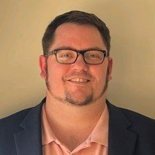

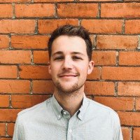
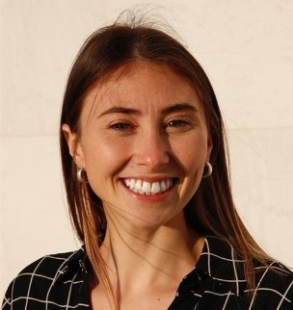
Who you’ll hear from
Lyle Hufstetler
Project Administrator
AACOG
Mariah Sanchez
Natural Resources Outreach Specialist
AACOG
Andrew Light
Clean Energy Associate
WRI
Lilyana Gabrielse
Clean Energy Analyst
WRI

Slide 4
Cohort and Session Overview

Slide 5
Cohort structure & timeline
February 27, 2025
Session #1: Setting the stage for solar development
Session 2: Planning for solar
Best practice guidance for planning and zoning of small and large-scale solar arrays
Session 3: Permitting & inspection for solar
Session 4: Community engagement & municipal operations
Guidance on how to support residents, businesses, and your own operations teams as they consider adopting solar
June 5, 2025
March 27, 2025
July 31, 2025
Session 5: Wrap up & next steps
Address any outstanding questions and chart a pathway forward
April 24, 2025
Overview of regional and state energy context
Training on best practices for permitting and inspecting solar arrays

Slide 6
Session 5 overview
This session will mainly focus on resilience
Attendees do not earn specific criteria solely by attending today’s session.
All the topics discussed today can be the basis for individual TA, so please don’t hesitate to reach out if you’d like tailored support.

Slide 7

A refresher on the pathway to Bronze
Solar Statement (Prereq.)*
Permitting/Inspection; 20 Points
  PI-1: Permitting checklist (Prereq.)
  PI-2: Permitting training (10 pts)*
  PI-3: Inspection training (10 pts)*
Planning & Zoning: 20 Points
  PZ-1: Zoning review (Prereq.)
  PZ-18: Planning/zoning training (10pts)*
  Community chosen action (10pts)
Special Focus Categories
  GO-13: Regulatory/Market Training (10 pts)*
  CE-1(+): Solar landing page (10+ pts)
Complete 3 prerequisites 20 pts in Permitting & Inspection 20 pts in Planning & Zoning 60 pts total
  * Actions that you may have already achieved

Slide 8
For communities interested in Silver
Permitting/Inspection
  PI-2: Permitting training (Prereq.)*
  PI-3: Inspection training (Prereq.)*
Special Focus Categories
  CE-1: Solar landing page (Prereq.)
Planning & Zoning
  PZ-4 or PZ-5: Rooftop solar as a by-right accessory use (Prereq.)
Complete 4 prerequisites 100 total points
Your community must decide how to achieve ~40 points, but 20-30 points can be easily achieved through resources on the solar landing page
  * Actions that you may have already achieved

Slide 9

For communities interested in Gold
Permitting/Inspection
  PI-4: 3-day permit turnaround time (Prereq.)
  PI-2/3: Permitting and inspection training*
Planning & Zoning
  PZ-5: Codify solar accessory use (Prereq.)
  PZ-6: Zoning barrier removal (Prereq.)
Special Focus Categories
  CE-1: Solar landing page
Complete 4 prerequisites 200 total points
  * Actions that you may have already achieved

Slide 10
How Many Points Do You have?
Regulatory/Market Training
February 27th
Recording
Verification Memo
Planning & Zoning Training
March 27th
Recording
Verification Memo
Permitting and Inspection Training
Office hours on April 24th
Recording of the Training
Verification Memo
10 Points +
10 Points +
20 Points
40 Points
Only 20 more are needed for designation
Notes:
So for Bronze, you only need to complete the 3 prerequisites and find 20 more points, 1 action from the Planning & Zoning Cateogry and then we recommend through the Solar Landing Page action item (CE-1)

Slide 11
Peer check-in prompts
Please share:
Your name and community
What designation level you’re pursuing
What have you been working on related to SolSmart designation since our last cohort session? Do you have any upcoming needs?
Any additional updates for the benefit of the group?

Slide 12
Initial Considerations for Enhancing Resilience

Slide 13
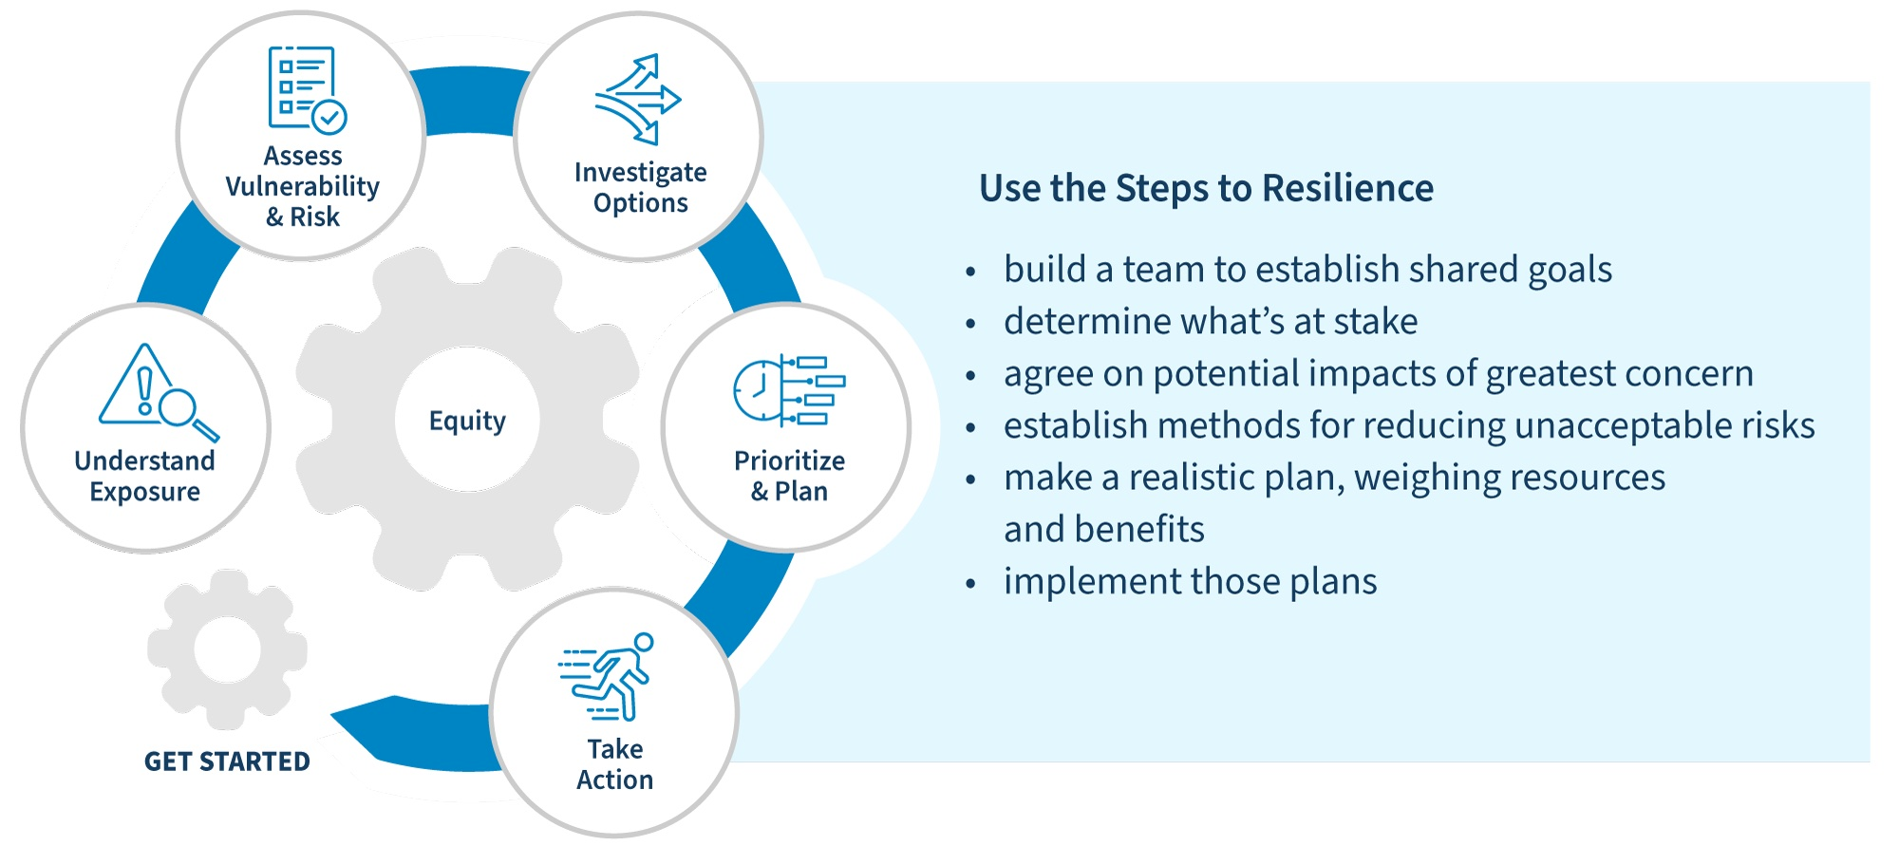
A stepwise process for developing a resilience project
Source: https://toolkit.climate.gov/steps-to-resilience/steps-resilience-overview

Slide 14
Engaging with key stakeholders is a critical part of developing a successful resilience-focused project
Key stakeholders to engage include:
  Community-based organizations
  Potential site hosts
  Utilities
  Installers/project developers
  Community members
  Relevant municipal staff and leadership
Each of these stakeholders will have different roles throughout the stepwise process – from ideation through implementation and operations and maintenance.
Clear and consistent communication can be vital to a project’s success.

Slide 15
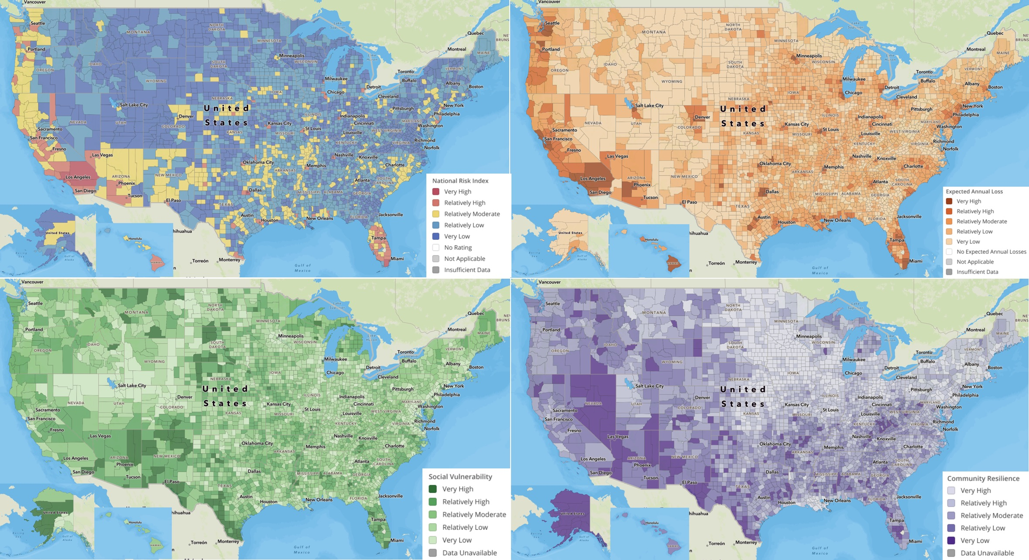
Analyzing risk can help to determine where and how to deploy resilience-focused projects
FEMA’s National Risk Index
There are several types of hazards and associated risks. The components of these risks include exposure, frequency, and vulnerability..
There are several grid indices to consider:
  System Average Interruption Frequency Index (SAIFI)​: The total number of customer interruptions divided by the total number of customers served in a given period, usually a year.
  System Average Interruption Duration Index (SAIDI)​: The total number of minutes of customer interruptions divided by the number of customers served during a given time period.
  Customer Average Interruption Duration Index (CAIDI)​: Total number of minutes customers are without service divided by the total number of interruptions.
Source: https://toolkit.climate.gov/sites/default/files/Nat%27l%20Risk%20Index%20Overview_0.jpg

Slide 16
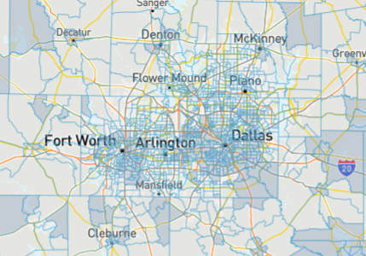
Considerations for determining where to site resilience projects
Key questions to ask
  Where are people more vulnerable, especially to the risks identified by previous research and community engagement?
  Where do community members access services?
  Are there equity implications to locating resilience hubs or microgrids in certain areas? Or other co-benefits associated with siting options?
Tools exist, such as CEJST, to help identify potential geographies that will benefit from enhanced resilience, and there are also mapping tools to help identify potential sites.
Engaging with community members to better define where to site a resilience hub or microgrid will provide valuable on-the-ground context that’s missing from maps.
The CEJST Mapping Tool can help identify disadvantaged communities

Slide 17
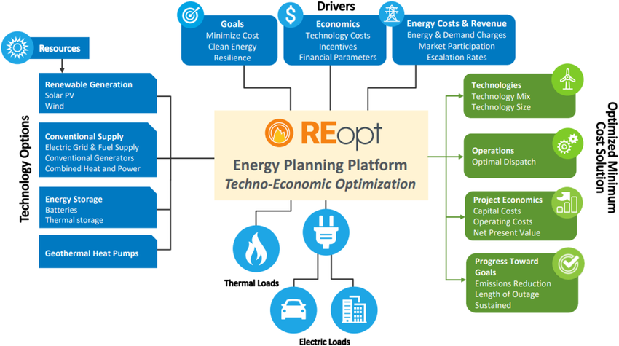
There are multiple technologies and combinations of technologies that can be integrated into resilience projects
Source: https://www.researchgate.net/figure/Schematic-of-REopt-model-inputs-and-outputs_fig2_375313773

Slide 18
Additional considerations as you advance resilience-focused projects
Adding technologies to enhance resilience will increase the capital costs of a project, but may not lead to similar payback opportunities for system owners.
  Determine if there are ways to recoup costs (e.g., participating in a virtual power plant or utility program) or quantify the value of resilience to help demonstrate the payback in a different way.
Several unique funding streams may support resilience-focused projects, such as:
  Texas Energy Fund's Backup Power Packages
    Loans or grants to install a backup power package (a stand-alone, behind-the-meter, multiday backup power source) on public facilities that communities rely upon for health, safety and well-being, excludes for-profit and commercial market segments
    Funds for design, procurement, installation, and use of back-up power packages; Individual grants capped at $500/KW of capacity; cap of $1.8 billion total for grants and loans
  FEMA's Building Resilient Infrastructure and Communities (BRIC) grant has recently expanded to allow for solar and storage, but the recent round of funding recently closed
Procurement steps largely align with similar procurements for other technologies, but it is important to be clear about the resilience needs and the desired operations and critical loads to help ensure RFP responses are best aligned with local goals.

Slide 19
Cohort Next Steps and Close Out

Slide 20
Achieving Your Community's Desired Tier of Designation and Beyond
Today is the final cohort session, but we don't expect communities to have achieved designated yet and we know you're actively working on various criteria.
SolSmart staff can still provide targeted assistance to support achievement of designation requirements (and more), and we're happy to schedule 1-on-1 calls with any of the cohort members.
Communities can provide verification materials to Lilyana Gabrielse (Lilyana.Gabrielse@wri.org) either in a final batch or as they're completed, and she will submit all materials to the designation review team:
  Each criteria has specific verification requirements that are listed in the program guide. Verification may be a link (e.g., for a permitting checklist or solar landing page), a memo (e.g., for a training not provided through the cohort), or something else.
  Feel free to reach out with questions pertaining to acceptable verification material
Communities have an opportunity to level-up to a higher designation tier in the future.

Slide 21
Ongoing Technical Assistance Support
SolSmart can provide technical assistance on a variety of issues. This support does not have to be tied to designation requirements, and it is still available after designation occurs.
Planning and zoning
Feasibility assessments
Permitting and inspection
Financing
Procurement
Stakeholder Engagement
Notes:
So across the SolSmart team we have quite a few organizations all housing specialized knowledge and expertise needed to remove barriers in categories including the following. We can tap in to a lot of different resources to support Tempe in a specialized way across your goals – for FREE, paid for by the DOE

Slide 22
Final Survey Requirement
To receive designation, all communities must also complete a final survey:
https://irec.typeform.com/to/TYPJ8A8p
It's fine if you're unable to answer a question or have to put "N/A" or "No data." Please complete as much as possible. SolSmart staff are happy to walk through this with you, if helpful.
Notes:
So across the SolSmart team we have quite a few organizations all housing specialized knowledge and expertise needed to remove barriers in categories including the following. We can tap in to a lot of different resources to support Tempe in a specialized way across your goals – for FREE, paid for by the DOE

Slide 23
AACOG's Road to Gold
AACOG is currently pursuing Silver. After achieving Silver, AACOG will seek to achieve Gold and will need your support!
PR-6: Collect and post member government energy targets for solar PV (e.g., # of installations, MW capacity, kWhs generated cand/or procured) and progress against stated targets. To receive credit, regional organizations with 10 or fewer members must collect data from at least two communities. Regional organizations with more than 10 members must collect data from at least four communities

Slide 24
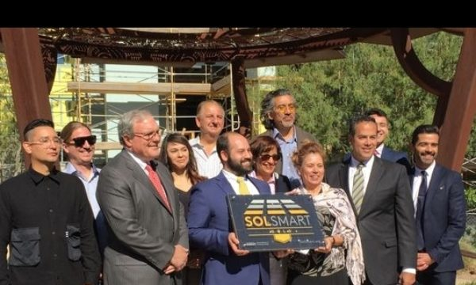
Publicity for the Region’s Achievements
Once designation is confirmed, SolSmart communications staff will connect with a community and provide:
  A communications toolkit
  Ideas for publicizing designation, including press releases and events
  Information about how to get your plaque

Slide 25
Final Thoughts & Reflections
What did you find valuable about the cohort?
What could be improved in future cohorts?
What questions or thoughts are you still holding onto?

Slide 26
Thank You!
If you have final questions or thoughts about the cohort, please reach out to Mariah or Lyle
If you have questions about SolSmart or external TA, please reach out to Lilyana Gabrielse (Lilyana.gabrielse@wri.org)

